Slide 1
LEARN ABOUT YOUR TERRITORY AND ENCOUNTER ITS ART
Educational activities for the final three years of secondary school
ARCHAEOLOGOCIAL MUSEUM IN NOCERA UMBRA
REAL LIFE OR VIRTUAL VISIT

Slide 2
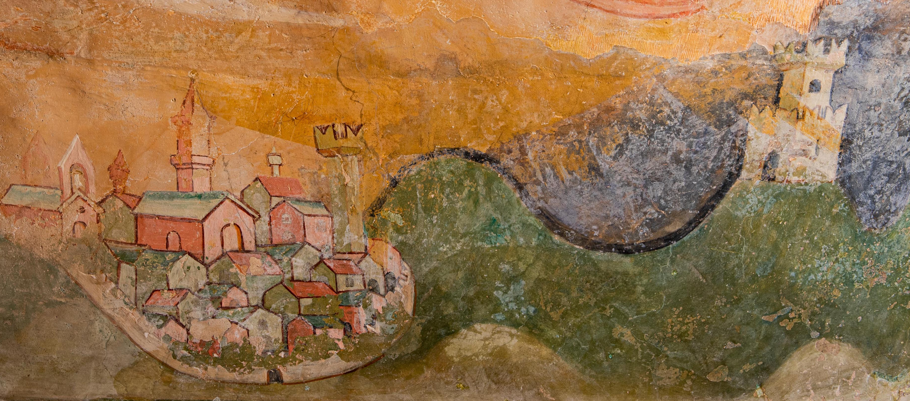
Objectives
Acquire an informed approach to interpreting images, through an iconographical and iconological analysis, while learning more about the territory, its communication routes and the historical footprints left by Man, its contacts with the outside world, trade and economy and their contribution to sustaining the quality of life in Nocera Umbra and the surrounding area, as well as the presence of religious sites which, over the course of history, have ennobled these human settlements.

Slide 3
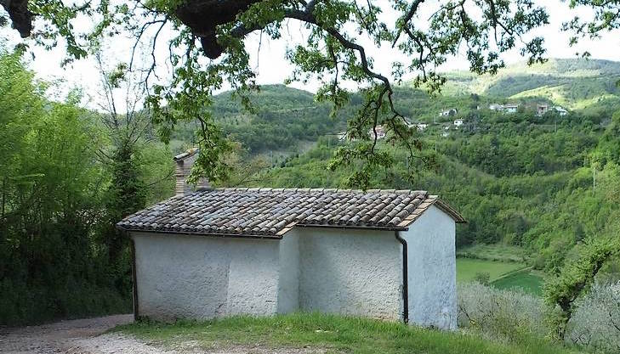
Studying the works of art in one’s territory can promote transversal skills. Knowledge of history and culture, acquisition of an analytical method, and the ability to interpret a work of art and artefacts in the light of their iconography and iconology are the desired results for the pupils.
Knowledge of one’s own territory is an essential component in the formation of every citizen and, therefore, of fundamental importance in pedagogical and educational programming.

Slide 4
ARTICLE 9 OF THE ITALIAN CONSTITUTION
The Republic promotes development and scientific and technical research.
It protects the landscape and the historical and artistic heritage of the Nation.
The present article concerns certain constitutionally relevant assets and values regarding and defining the relationship between Man and the Natural World.
The landscape identifies the visible environment, that is to say those aspects of the relationship between Man and Nature that manifest themselves in the configuration of the territory. Finally, the cultural treasures that compose the national historical and artistic heritage, consist of all the movable and immovable property which are of artistic, historical, archaeological, ethno-anthropological, archival or bibliographical interest together with any other property defined in law or on a legal basis as having civil value. The word ‘Patrimony’ ( deriving from pater), signifies a hereditary legacy, capital which we are endowed with from birth, without any effort on our part; the word “cultura” derives from the Latin verb colere, meaning to cultivate. This means that we have the moral duty to cultivate our ‘capital’, whether it is cultural or natural.

Slide 5
The Via Nocerina goes from Nocera Umbra along the River Topino as far as Casebasse, and from there, by way of the Church of Santa Croce della Ficarella it reaches Bagni di Nocera Umbra, then the Ferri Mill in the vicinity of the Acciano Dam, passes below Sorifa near the Balze waterfalls, ascends to Serre di Mosciano, Collecroce, crosses the plateau to reach Annifo, from where, in the direction of the Vaccagna Valley, it goes straight to Plestia, crucial intersection of the ancient Vie (La Spina, Lauretana, Della Val Sant’Angelo, Della Scurosa etc....
Ancient reports tell of entire populations transiting the Via Nocerina whether on foot, in carts, on horseback or on other beasts of burden especially when fairs, markets or other social gatherings were taking place.
The numerous springs provided refreshment for the people undertaking this difficult journey especially the uniquely abundant “Acqua Angelica”, (clear and Holy...)

Slide 6
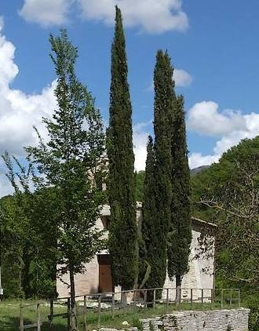
We have to learn to focus clearly, to train our eyesight to seek out among the folds of the valleys and then be able to discern, to our amazement, features of the environment or ancient buildings which constitute points in the landscape full of history and fascination. Some apparently impervious places can sometimes reveal Man’s presence and still conserve unsuspected artistic treasures.
Santa Croce della Ficarella, ex monastero sotto il patronato dell’abbazia di Fonte Avellana

Slide 7
It is with this in mind that we discover a tiny stone chapel, the Maestà di Acciano, a small building which contains an incredible series of paintings.
The protagonist of this cycle of paintings is Saint James the Great, the Apostle is dressed as a pilgrim, with a pilgrim’s staff and money-bag, a hat bearing a scallop shell and a book. His cult was widespread in the 11th century and Santiago di Compostela was the most important shrine to visit for pilgrims desirous of an encounter with the Apostle. It is not difficult to imagine that this place could have offered shelter to the numbers of pilgrims and wayfarers who, as they made their way along the ancient Via Nocerina, could find some devotional comfort here before setting out again on their way to Nocera.
The Maestà d’Acciano with its history and priceless beauty will be the object of detailed study in the teaching unit proposed.

Slide 8
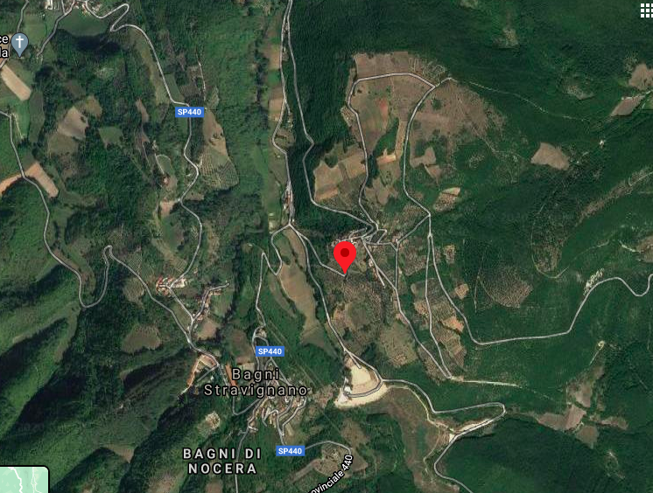

Slide 9
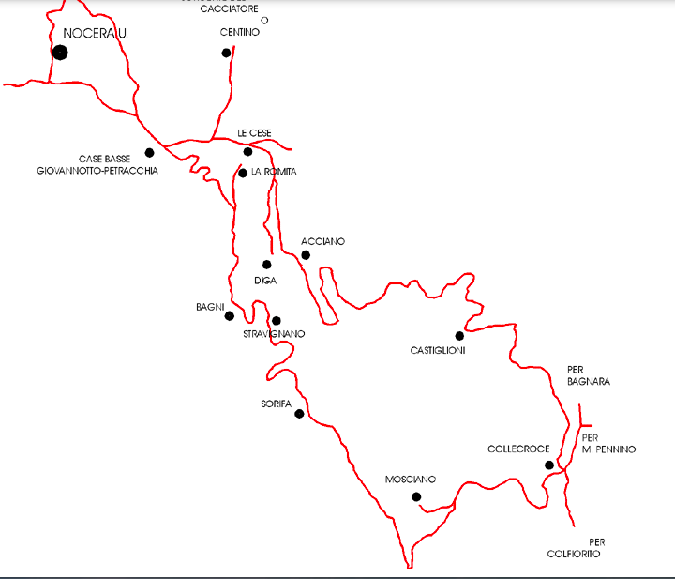
NOCERA UMBRA

Slide 10
A distinctive feature of the landscape of the Central Apennines is the rocky habitat and in the area our study is concerned with, there are numerous churches amid the crags. The most ancient part of this structure was originally intended as a rural Maestà and consists of a small rectangular room (2.73 x 2.33 m) with a barrel vault and an aperture on the side facing South.
Presumably, in front of the exterior of the arch there was a room with a gabled roof supported by two peculiar curved beams.
At a later date, the building was enlarged by prolonging the perimeter walls and utilizing the curved beams which already existed as support for the roof and thus creating the façade with a wide aperture out of proportion with the dimensions of the front of the building.
The construction of the original Maestà can be presumed to have taken place just before 1450 and the frescoes to have been painted shortly afterwards, since that was the year Saint Bernardino of Siena, who is depicted on the right-hand wall, was canonised.
The little bell-tower in brickwork is of recent construction and was badly damaged in the 1997 earthquake, as was the rest of the building, which subsequently, in 2000, underwent restoration together with the frescoes.

Slide 11
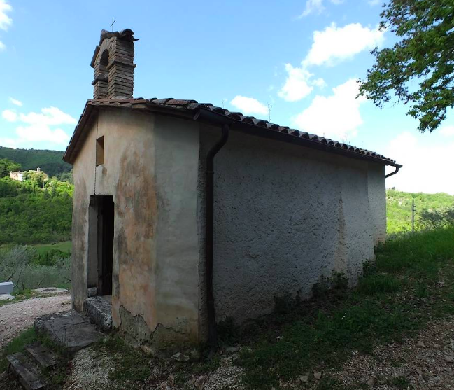

Slide 12
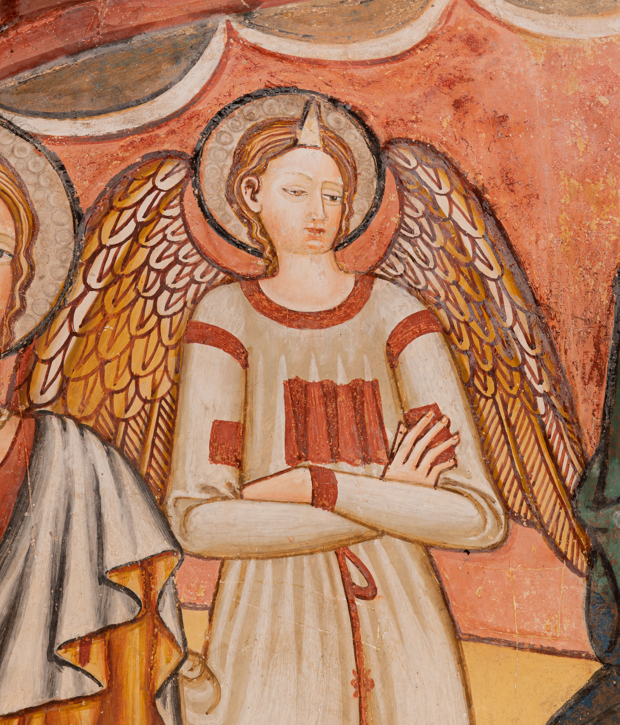
THE NARRATIVE IN A CYCLE OF FRESCOES
A series of paintings weaves together a story, so we have to ask ourselves this question: what is it intended to recount?
In line with the wishes of the person commissioning the work, the artist plans the execution of the paintings according to the available wall space; in conformity with tradition, the succession of paintings has a focal point, corresponding to the main theme, which is immediately visible on the rear wall behind the altar; the Enthroned Madonna suckling the Baby Jesus among angels and saints.

Slide 13
In order to understand the religious message which lies hidden behind the images depicted, it is necessary to recognise the saints occupying the foremost positions.
In the 15th century, from the Gothic period to the Renaissance, in Camerino, there was a highly respected artistic school which Zeri judged to be “ the most noteworthy school of painters in The Marches”.
The most prominent artists in the 14th qand 15th centuries were Carlo di Camerino and Giovanni Angelo di Antonio together with his alter ego and collaborator, Girolamo di Giovanni.
In his 2002 study, Professor Enzo Storelli attributes the cycle of frescoes in Acciano to an artist from the Camerino School.
The work may have been done between 1461 and 1465.
Due to the lack of documentary evidence of the contract between the artist and the patron, this study is founded on the numerous stylistic features in the work.
Everything leads to the conclusion that the work was carried out by artists from the School of Giovanni Angelo d’Antonio and Girolamo di Giovanni.

Slide 14
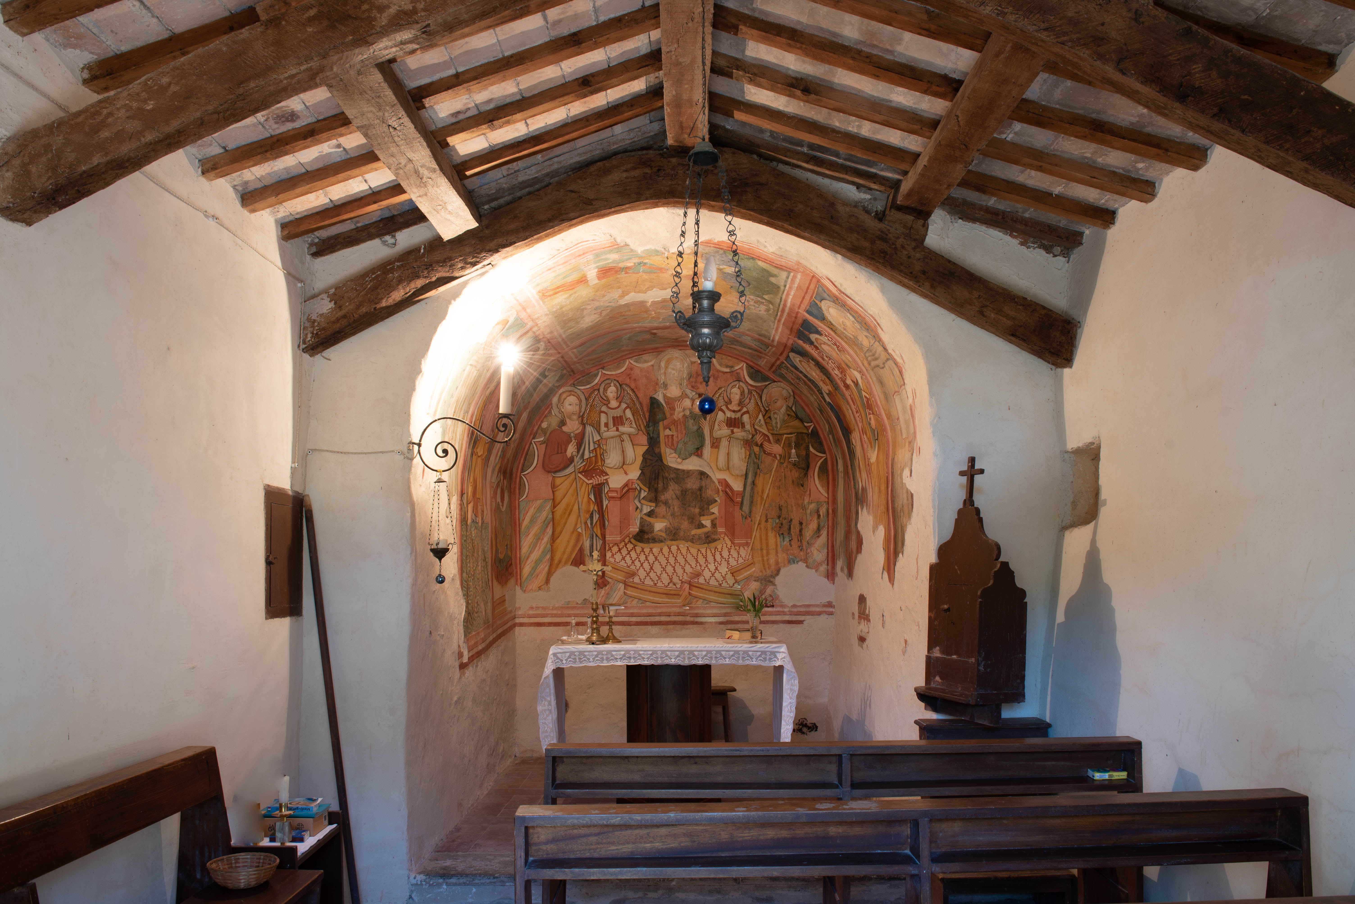

Slide 15
Almost all the 13th century depictions of the Madonna and Child are Maestàs (Majesties) like those by Coppo di Marcovaldo, or Cimabue or other contemporary painters.
Notable Maestàs were also painted by the innovative artists such as Giotto, Duccio di Buoninsegna and Simone Martini. In the following centuries, Maestàs continued to be produced even if examples with the main figures in isolation became more and more rare and were substituted by a scene with the Virgin Mary as the central figure and two or more saints on either side. The gestures and expressions of the lateral figures echoed each other so that they seem to be engaged in a sort of dialogue: from the 15th century on, this type of representation is known as a Sacra Conversazione.
The opposing theme to that of the Maestà is the image of the Madonna of Humility, in which the Virgin and Child are sitting on the ground, perhaps on a simple cushion. This type of iconography developed several decades later and was linked to the concept of Poverty in the Church as professed by the Mendicant Orders like the Spiritual Franciscans: in reality, the figure of the Madonna symbolised the Church itself with the Child as its Founder.

Slide 16
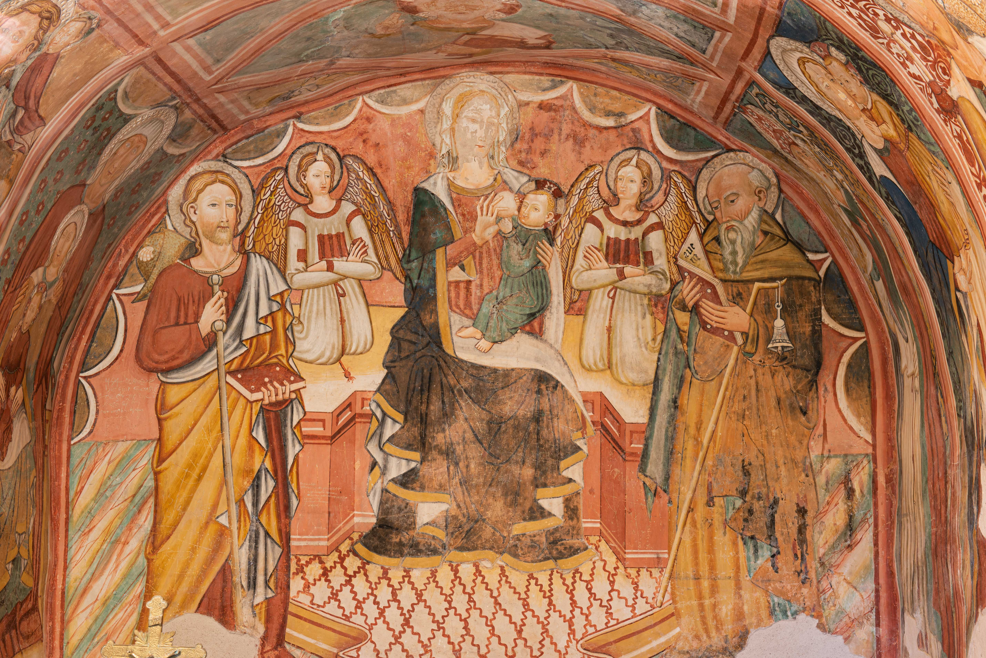

Slide 17
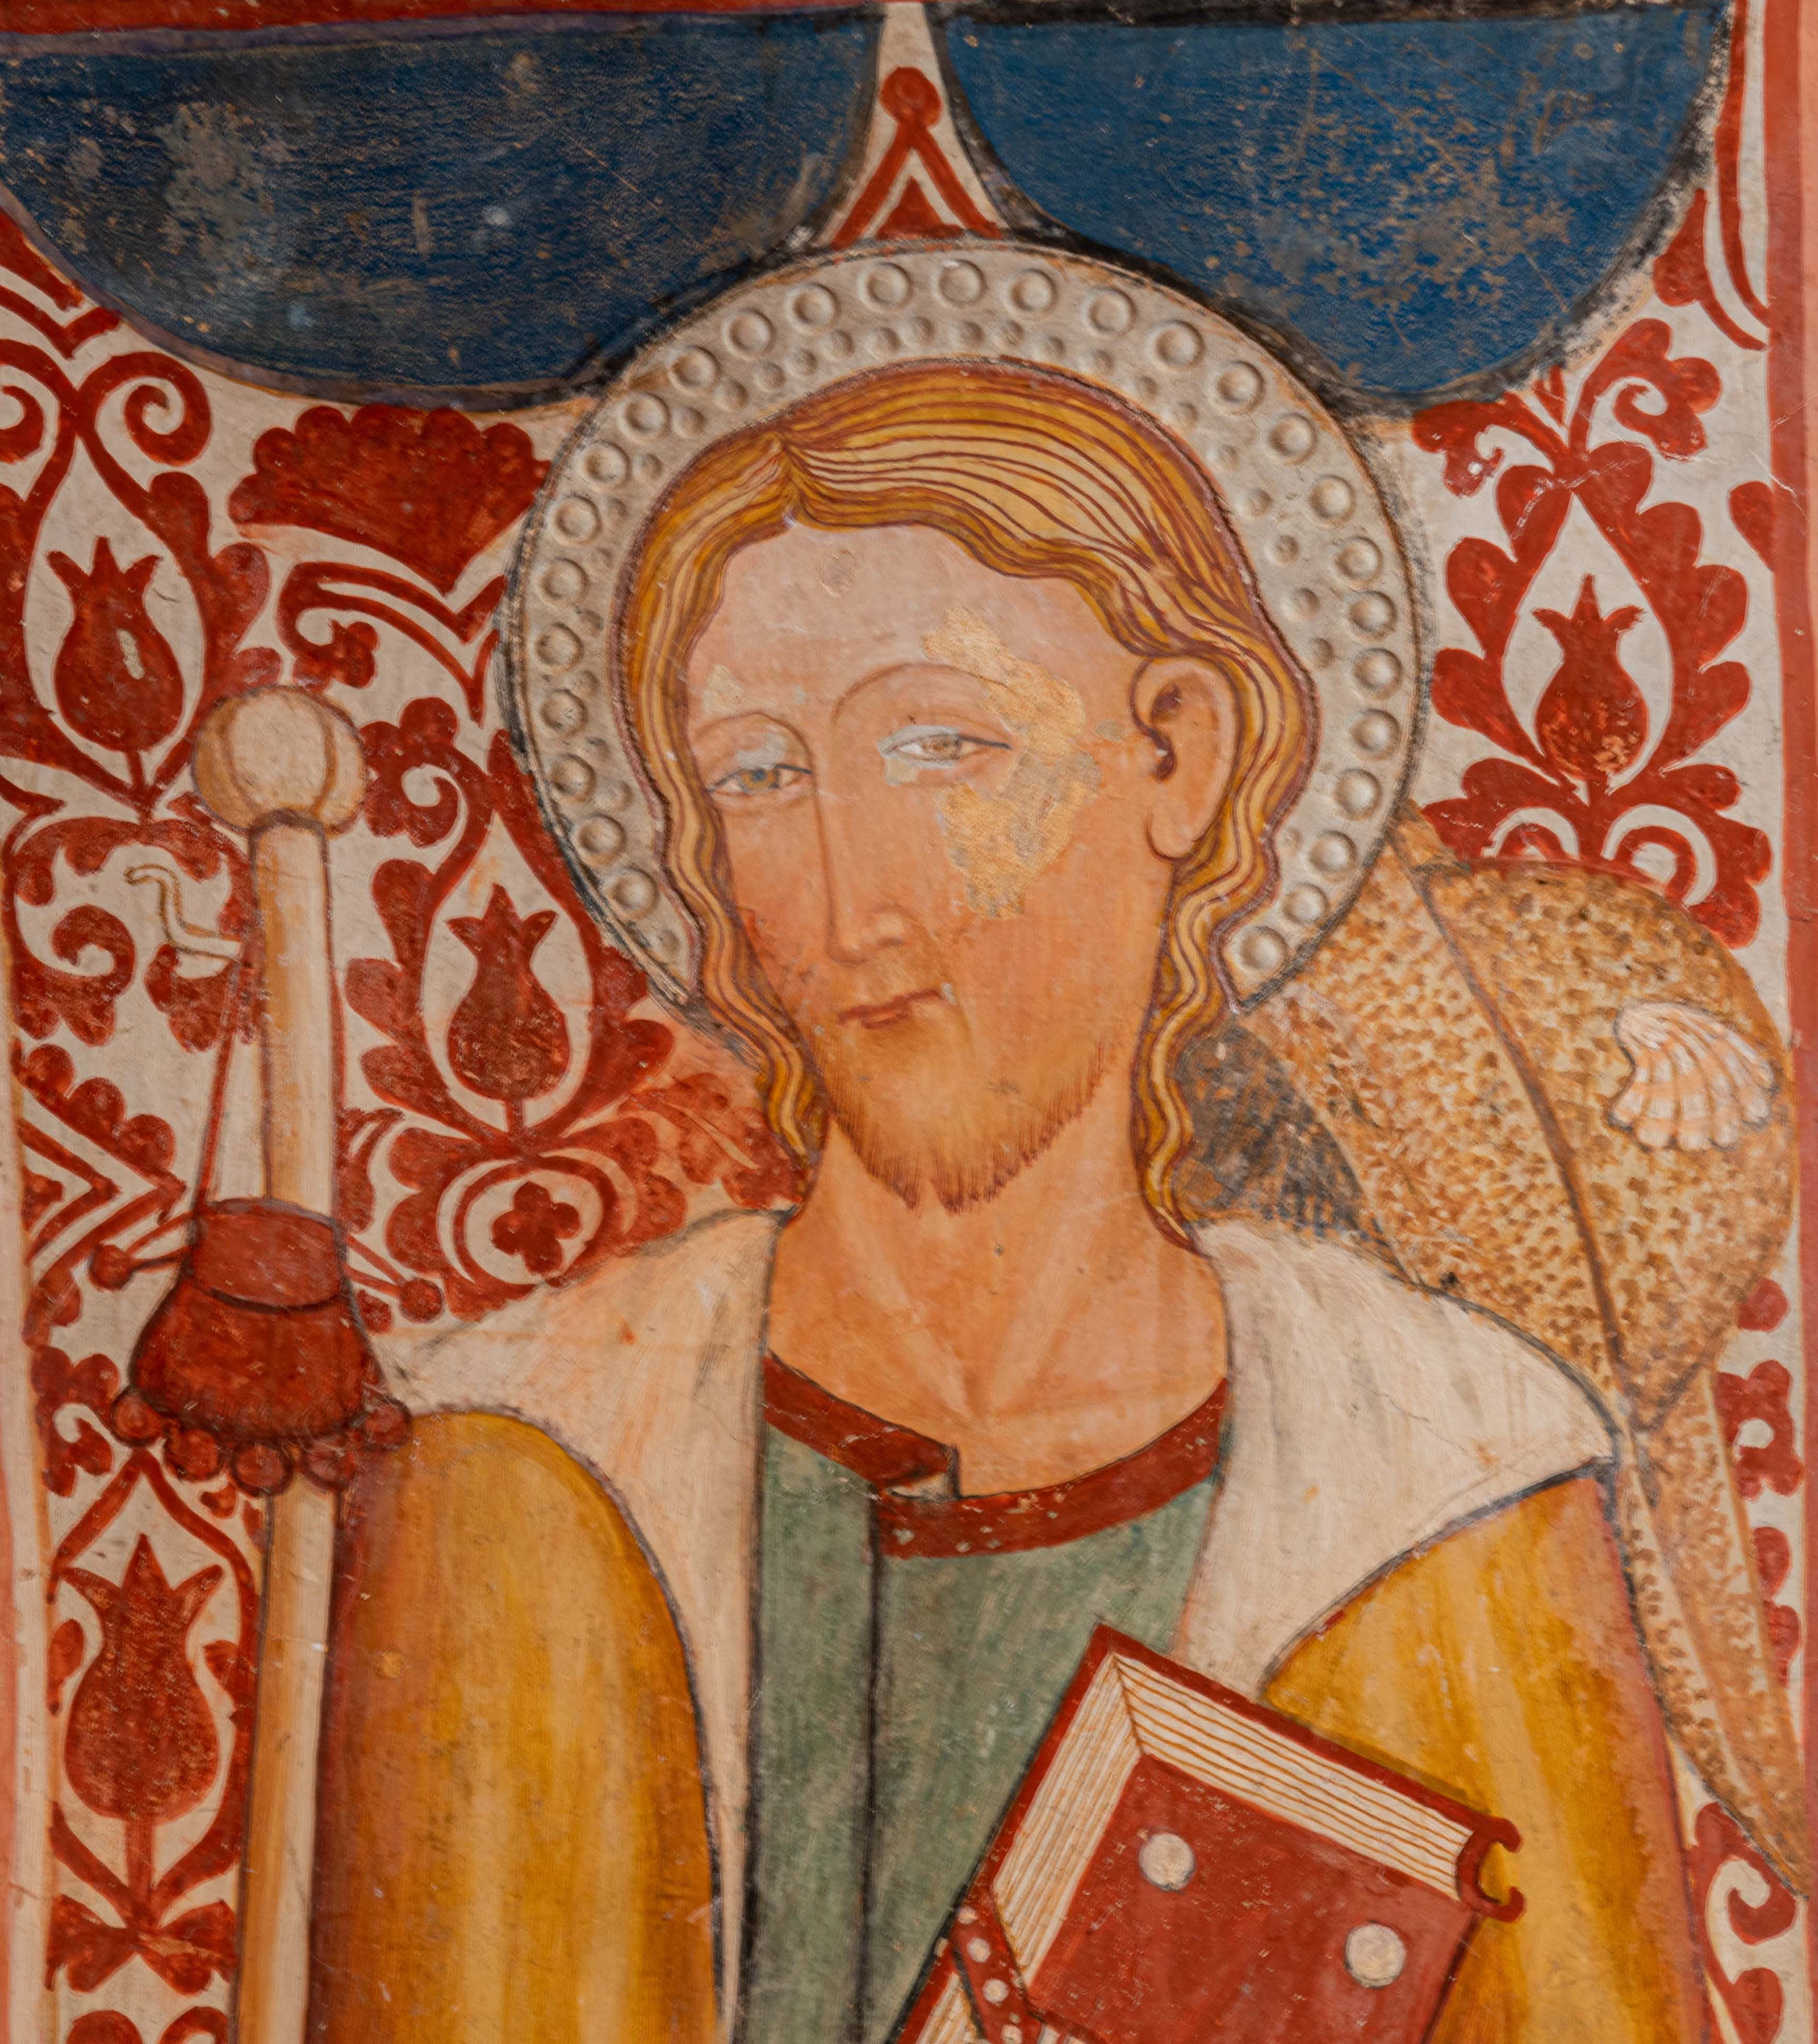
On the left, thanks to his iconographical attributes we can recognise St. James the Great, son of Zebedee and brother of St. John the Evangelist, about whom, in later centuries, a number of traditions and legends grew up. He is said to have preached the Gospel in Spain. When in the 9th century that country fell under Arab domination, the body of St. James (Santiago in Spanish) was believed to have been removed to that area.He is depicted dressed as a pilgrim, alluding to the Pilgrim’s route in Spain of Santiago de Compostela, the site of his tomb, and wears a hat with a scallop shell, carries a staff and money- bag and holds a volume of the Gospels.

Slide 18
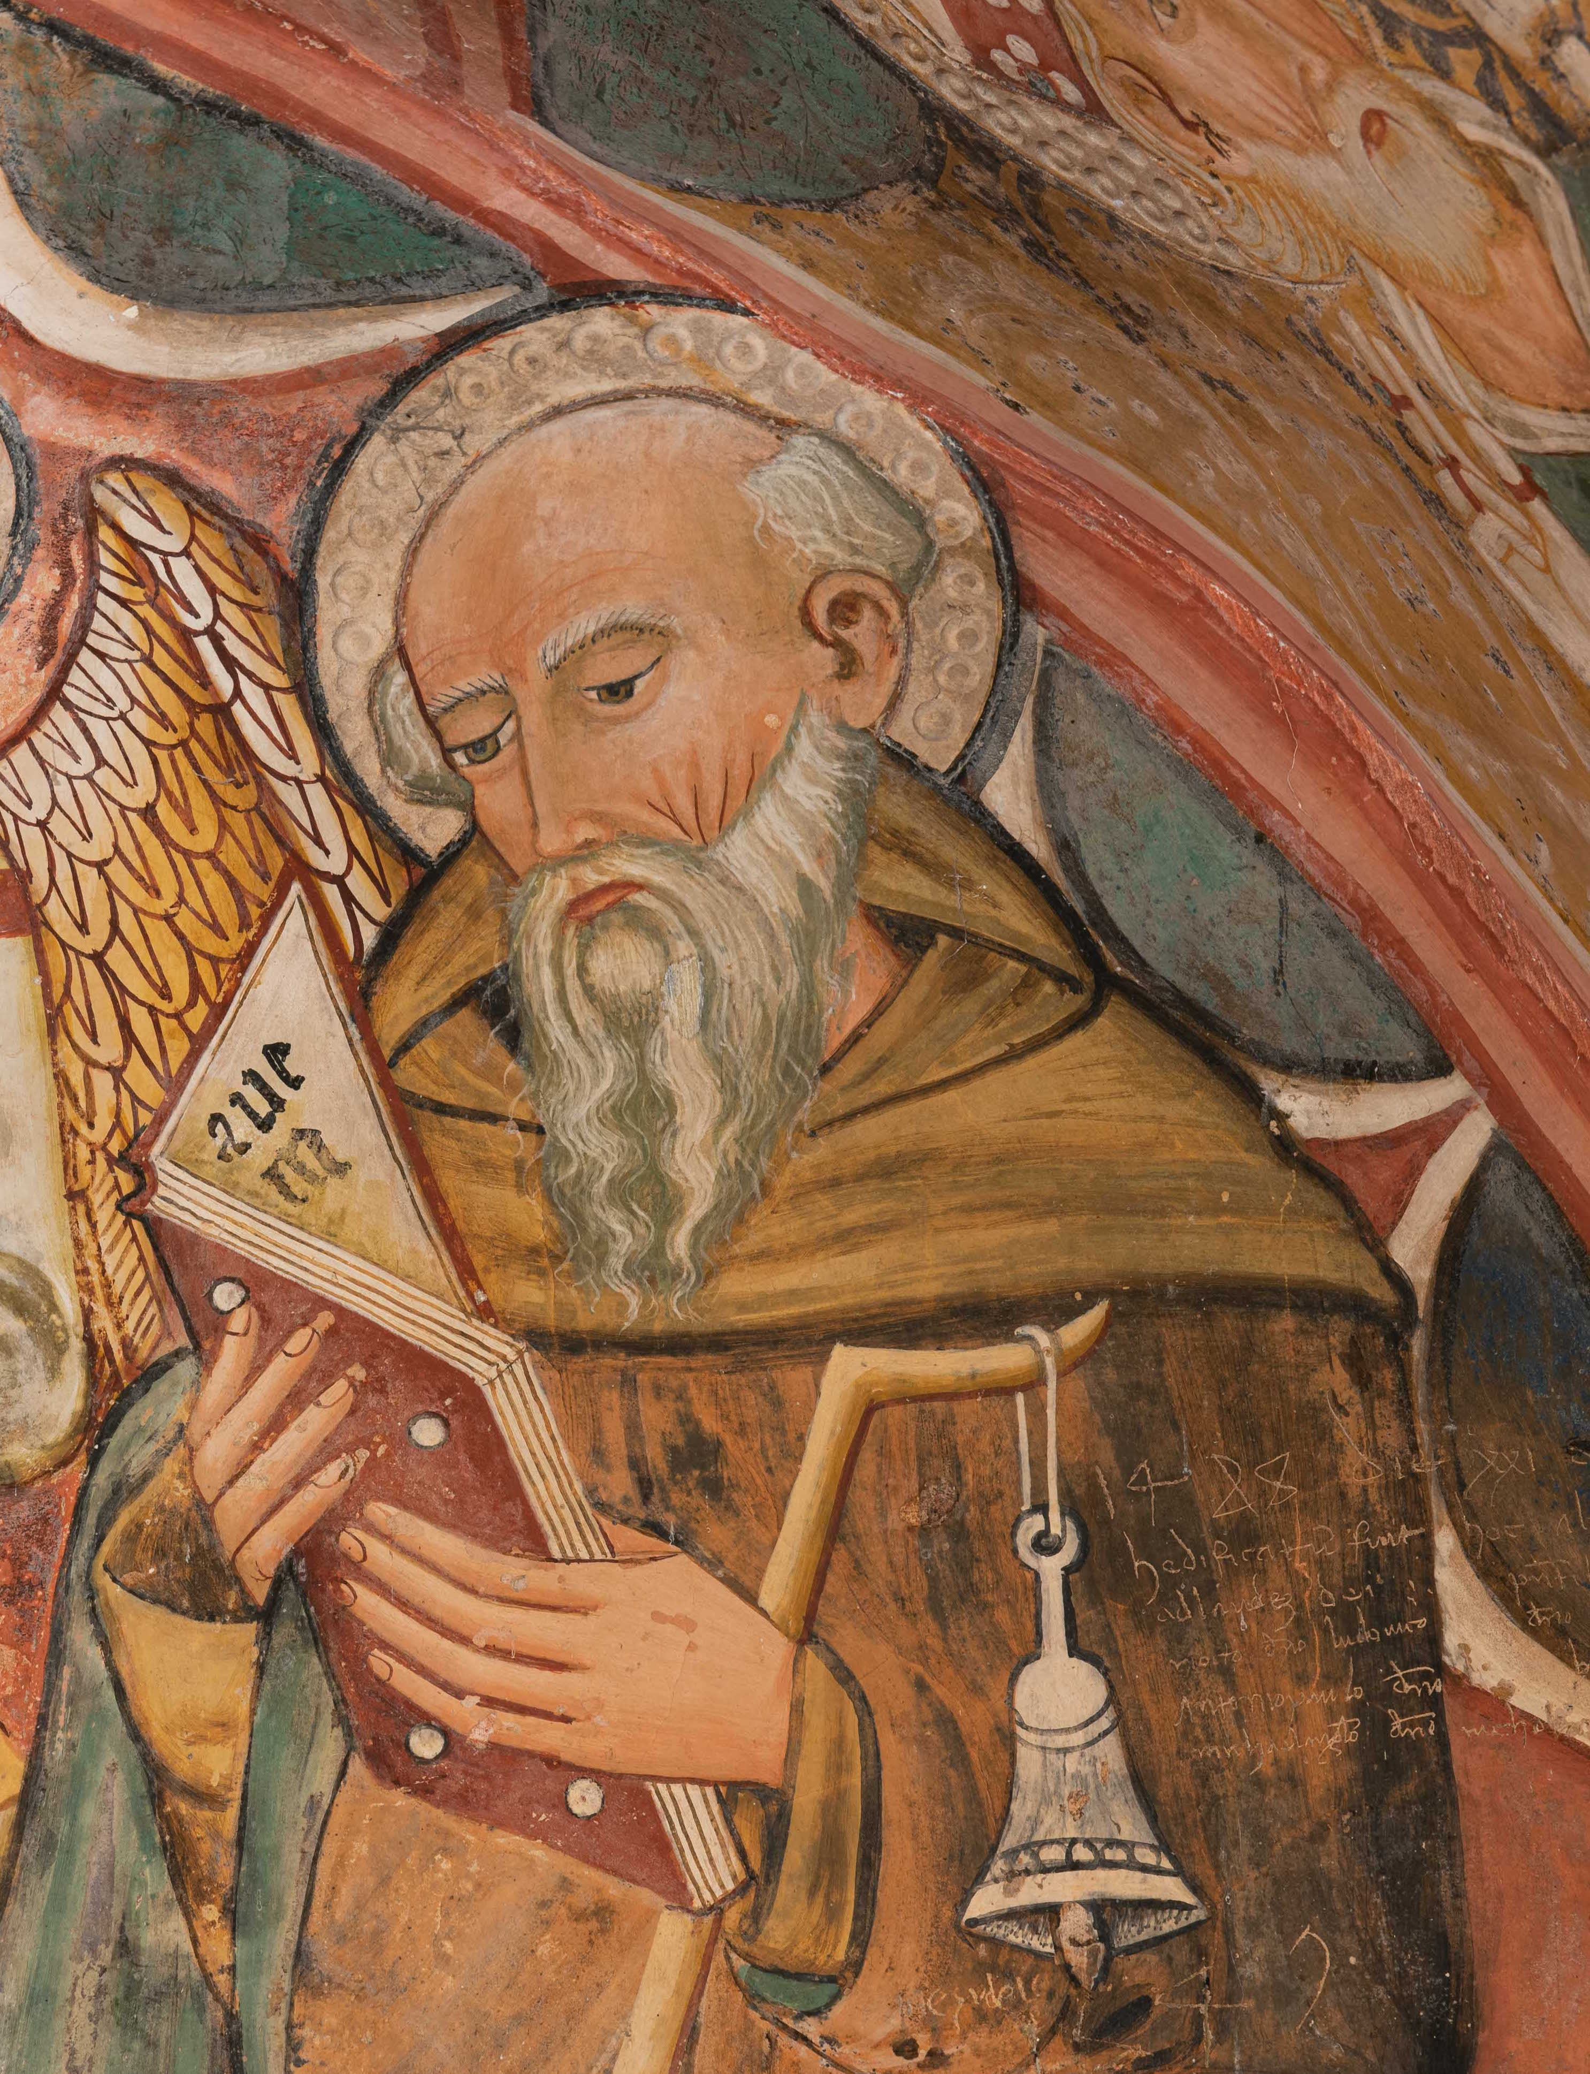
On the right is St. Anthony Abbot who is one of the most famous hermits in the history of the Church. He was born in Coma, in the centre of Egypt in about 250 CE and aged 20 he abandoned everything to go and live, initially, in a desert region and, later, on the shore of the Red Sea where he lived as a recluse for more than 80 years: in fact, he died at over a hundred in 356. Throughout his life, pilgrims and those in need from all over the East sought his help, attracted by the fame of his sanctity. His iconographic attributes confirm his identity in this image: a staff with a bell and a book of Holy Scripture in his hands.

Slide 19
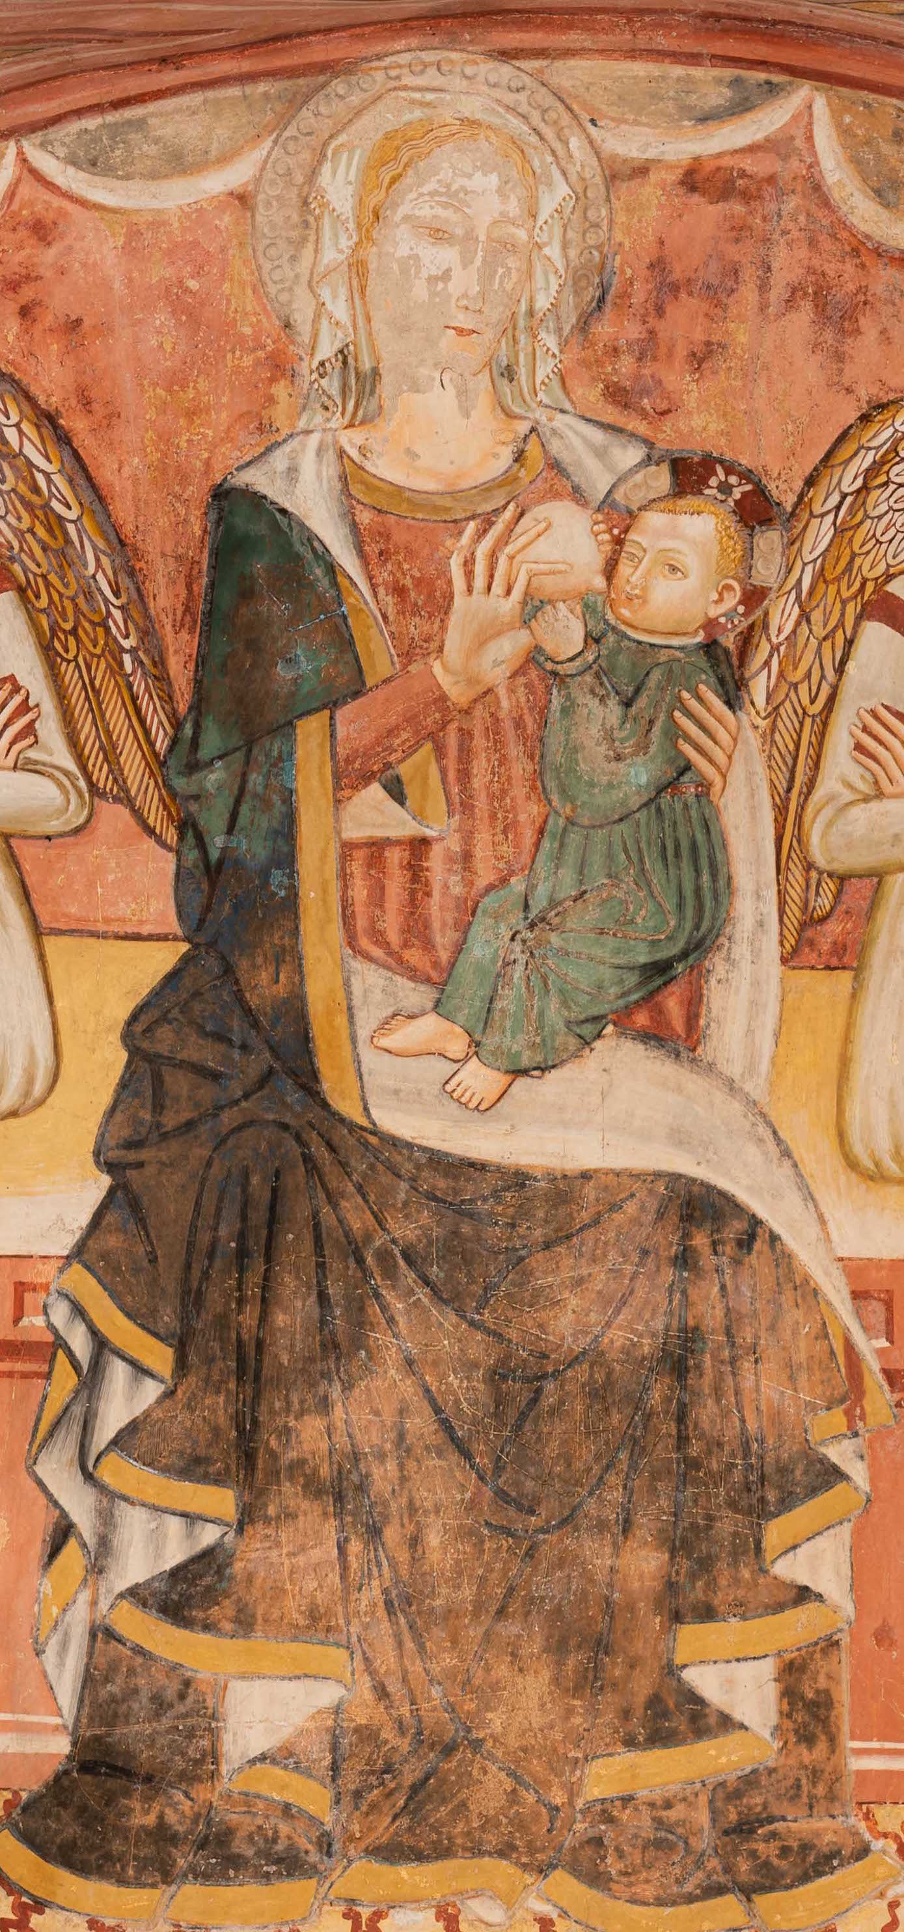
The Madonna Suckling the Baby Jesus. The origins of this iconography, known as the Galaktotrofousa (from the Greek meaning “she who nourishes with milk”) or under the Latin name, Virgo lactans, are still disputed by scholars. They are placed either in early Christian Coptic communities in Egypt, or in Rome. It became more widespread from the 13th century on and proliferated to an extraordinary degree in the quadrangular area between Como, Varese, Verbania and the Canton of Ticino, in the period from the 15th to the 16th century.
Starting from a quotation from the Gospel of St. Luke, “Blessed is the womb that bore you and the breasts that nursed you!”(11, 27), over the course of centuries, Christian tradition multiplied the references to Mary nursing her baby.
The Virgin’s milk even became a symbol and pledge of the grace which she obtains for the benefit of Mankind from Christ in an emotionally satisfying parallelism between the blood from the Son’s wounds and the milk from His Mother’s breast.

Slide 20
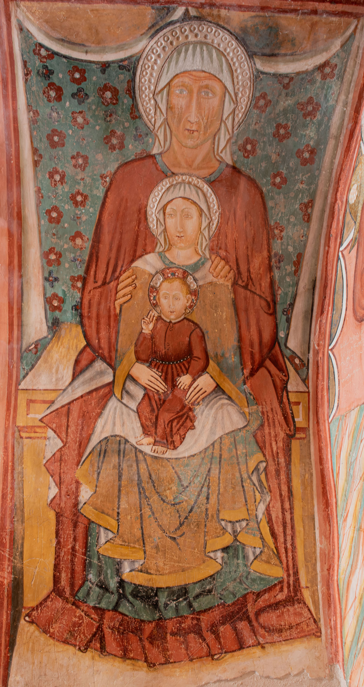
On the left-hand wall intersecting with the rear arch there are some other images of iconographical importance.
The first one depicts St. Anne, the Virgin Mary and Child. In an well-ordered and composed sequence, the figures appear close-knit and firmly united. In this portrayal of the Madonna and Child with St. Anne or “Sant’Anna Metterza”, as it is known, the underlying theme is the THREE generations.
This particular form of representation was introduced here from North-European culture (Germany) in the 15th and 16th centuries and became extremely popular in Italy, especially in Florentine art.

Slide 21
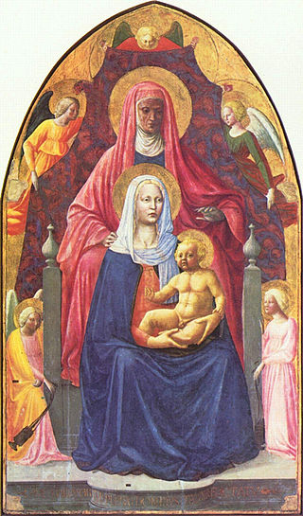
Artists: Masaccio and Masolino da Panicale
The “Sant’Anna Metterza”
Dated 1424 -1425
Technique tempera on wood panel
Dimensions 175 x 103 cm
Location Uffizi Gallery, Florence

Slide 22
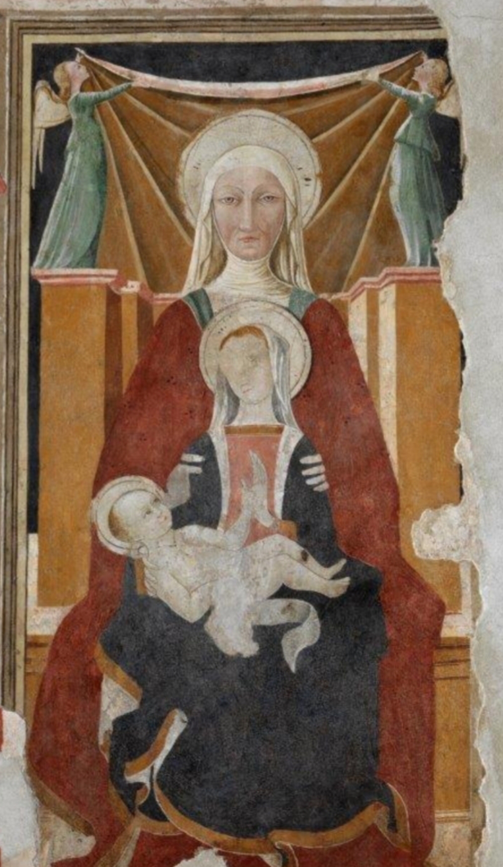
Church of San Francesco
Fresco attributed to Matteo da Gualdo
The “Sant’Anna Metterza”

Slide 23
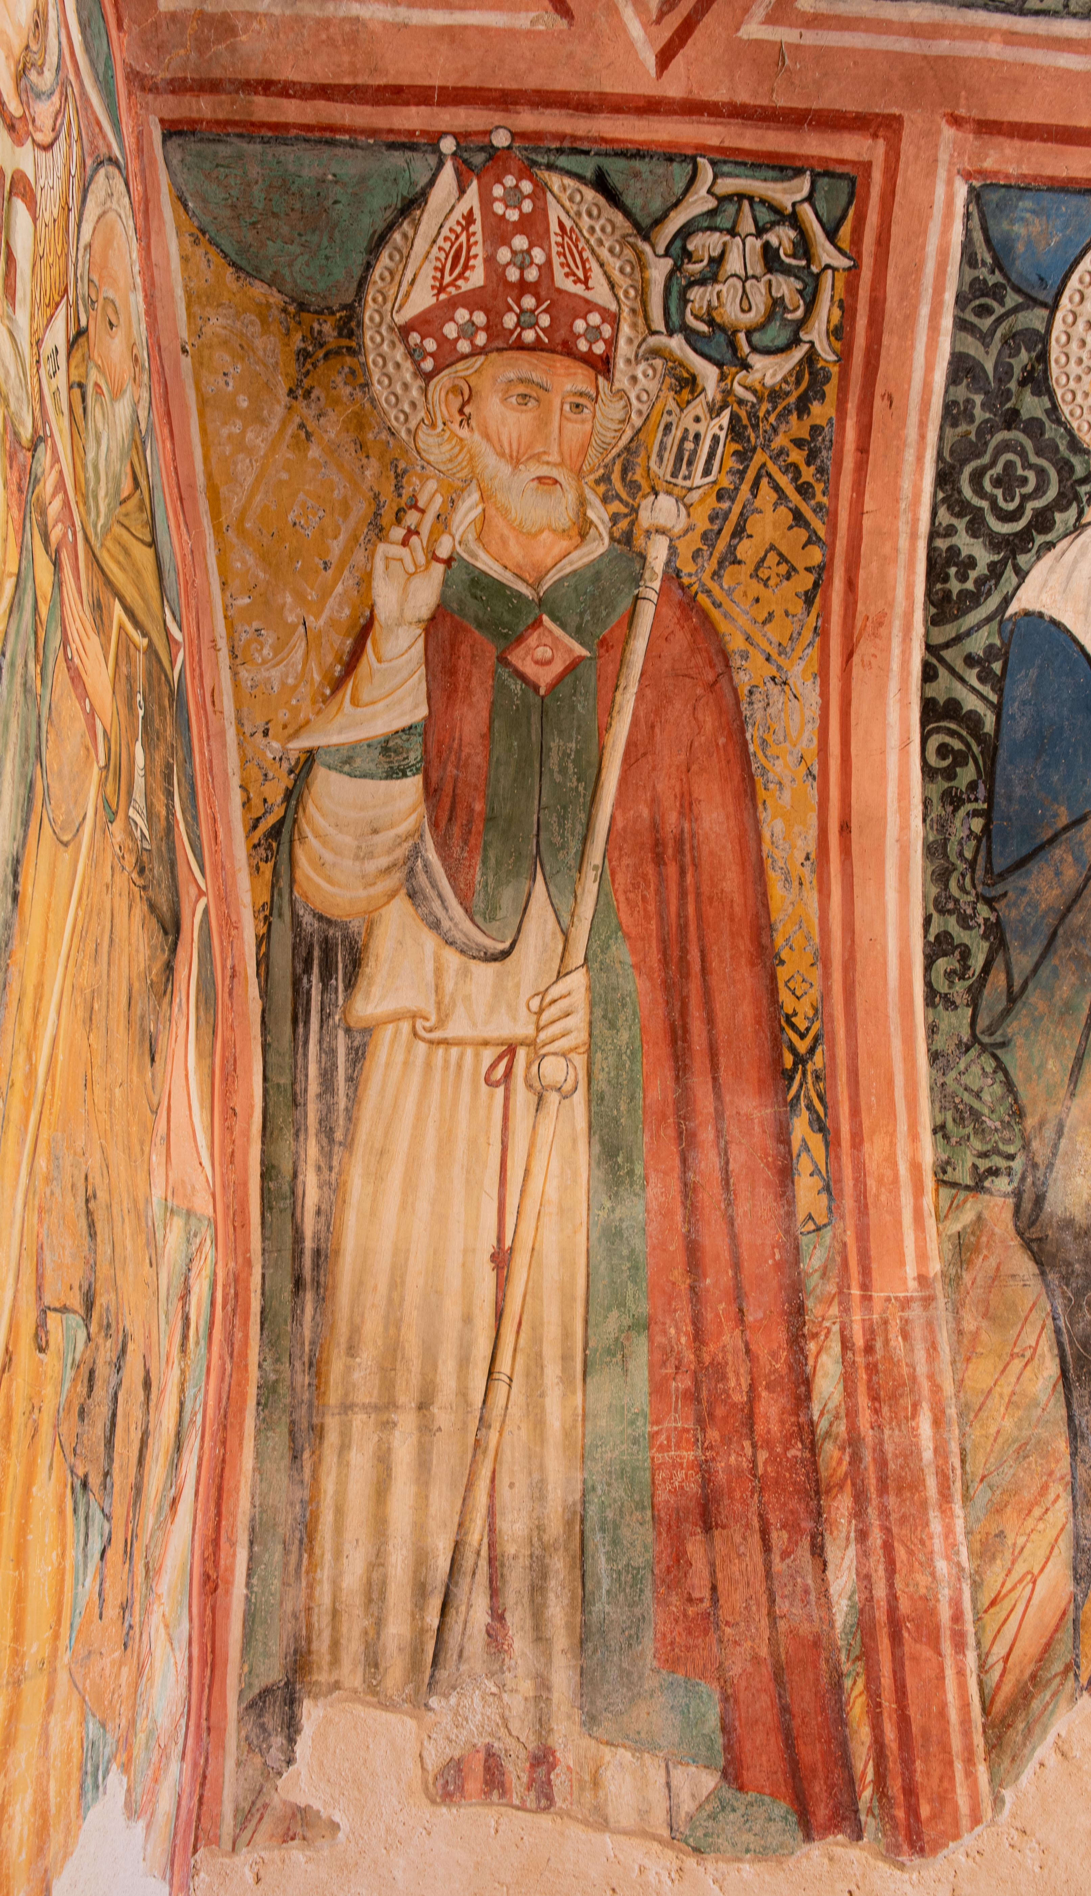
On the right-hand wall opposite the Sant’Anna Metterza, there is a depiction of Saint Rinaldo, the Patron of Nocera Umbra.
The Saint was a monk and Bishop in the Monastery of Santa Croce di Fonte Avellana. He was a contemporary of St. Francis of Assisi and like him, worked to serve God in a profoundly loving and merciful way.
He is portrayed here in his monk’s habit but the iconographic attributes also indicate the office Rinaldo held as Bishop of Nocera Umbra, the simple cope with juxtaposing contrasting colours, the richly ornate crozier and mitre all indicate his role.
The Saint is depicted in advanced years with a pure white beard surrounding his face and one hand raised in benediction to demonstrate his role as Bishop.

Slide 24
A few years later, in 1483, Saint Rinaldo was again portrayed in the exquisite polyptych by Nicolò Liberatore detto L’Alunno.
It was commissioned by Bishop Scelloni of Terni and Viterbo for the high altar of the cathedral where the Saint was buried. Here the Saint is depicted as more youthful, and is wearing a damasked cope embellished with a gold border and held together by a bejewelled clasp. His mitre is also richly ornamented with gold trimmings and two symmetrically placed jewels, his left hand is clasping his crozier while with his right hand he is holding up his cope.
His expression is composed and serene and he is looking downwards as a sign of silent adoration for the event of the Nativity which is being extolled by the choir of angels.

Slide 25
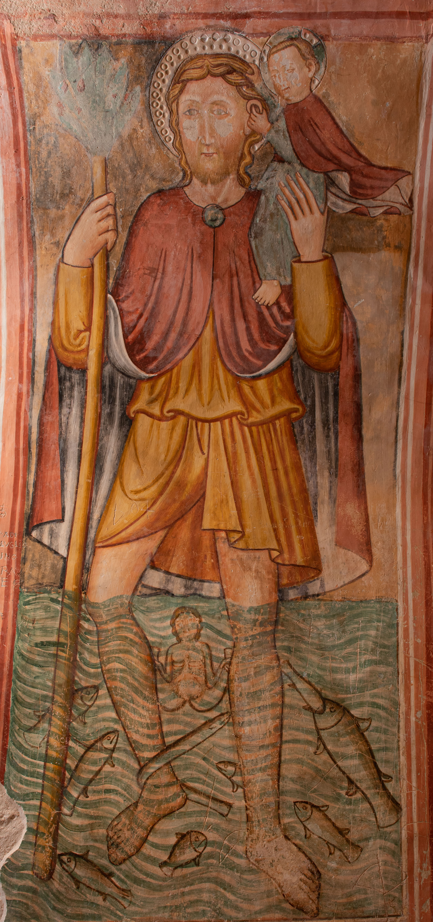
On the left-hand wall next to the Madonna Metterza we find: St. Christopher, who was martyred in Lycia, in 250, during the persecution under the Emperor Decius, is the man who is supposed to have carried a child on his shoulders who later revealed himself to be Christ. Legend has it that one night he was woken by a sweet little boy who begged him to ford him across the river; the Saint placed him on his shoulders but the further out he waded into the water, the heavier the child became, and it was only with great effort and by using his long, sturdy staff as a support (which miraculously blossomed into flower), that he was able to reach the other bank. Once there, the child revealed he was Christ and foretold that Christopher would soon be martyred. The protection of St. Christopher was especially invoked against the plague. What is surprising is the fantasy of the artist in recreating the underwater scene with various kinds of fish swimming around, but it is the little mermaid that captures our attention. The mermaid is an anthropomorphic figure half fish and half woman belonging to ancient myth but which in this iconography represents transformation, the metamorphosis that the prophesy of the Christ Child would bring about in Christopher’s life, changing it forever.

Slide 26
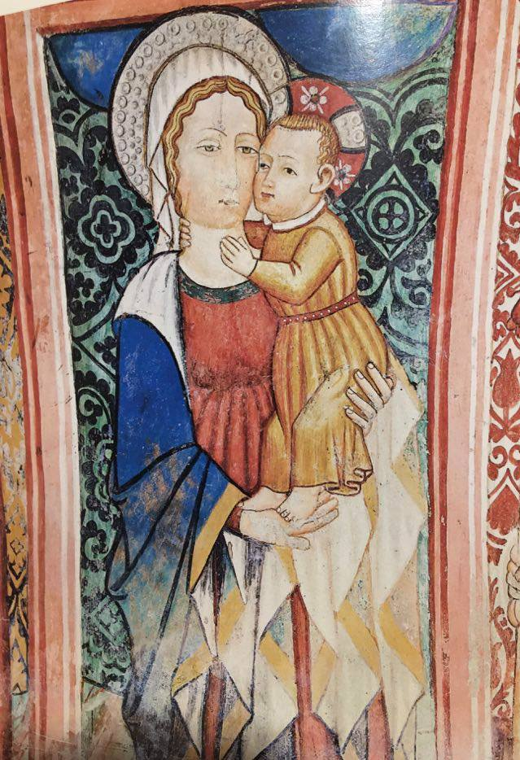
On the right-hand side, next to Saint Rinaldo, is a Madonna and Child. In this painting Mary is holding the Baby and they are shown to be embracing tenderly. This is a tranquil, reassuring image belonging to popular devotion.

Slide 27
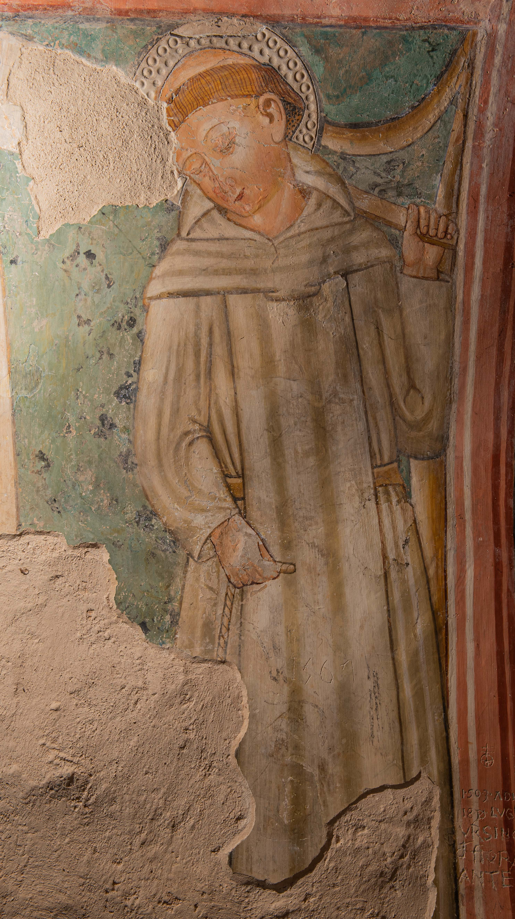
Saint Amico di Monte Milone. Amico di Rambona was born prior to 1000 in Monte Milone, a small town in The Marches now called Pollenza, in the Province of Macerata. Amico was the second Benedictine abbot of the Abbey of Rambona replacing Olderigo, who was abbot in 891. The Abbey of Rambona was founded on the ruins of a pagan temple dedicated to the goddess Bona Dea( hence the likely origin of the name Rambona) by the Lombard princess Ageltrude, daughter of Adelchis, Prince of Benevento, wife of Guido, Duke of Carnerino and Spoleto who, in 889, became King of Italy and Emperor in 891,she was also the mother of the Emperor Lamberto (892-898). The devotional figure of the Saint is accompanied by the wolf who had devoured his mare and who, thereafter, transported wood from the forest to the monastery. Amico is represented here clutching a tool for gathering wood in his left hand.

Slide 28
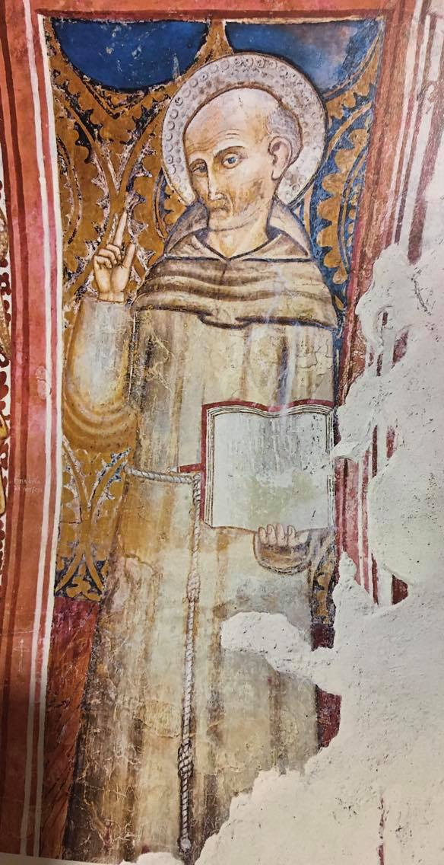
Canonised in 1450, a mere six years after his death, Saint Bernardino of Siena was born in 1380, in Massa Marittima, into the noble Sienese family of the Albizzeschi. Orphaned while still young, he was brought up by two aunts in Siena. He attended the Sienese Studio until the age of twenty-two and then joined the Franciscan Order becoming one of the major advocates for reform within the Observant Franciscan Movement. At the same time he began his extraordinary mission as a preacher in Italian towns where the squares were always thronged with the faithful and all the citizenry, with the town dignitaries at their head, and people even coming from nearby towns and villages, all flocking to hear him. Such was his fame that he was included in the fresco cycle of the Maestà di Acciano where he is depicted pointing upwards with the index finger of his right hand and holding the reformed rule of the Order which he himself had written.

Slide 29
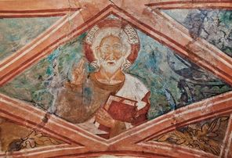
In one section of the barrel vaulting there is a lozenge-shaped frame enclosing an image of God The Father with a hand raised in blessing.

Slide 30
The Triumph of Death, and likewise the Dance of Death, present a medieval iconographic theme inspired by the sense of the transience of human life which was widespread throughout Europe after centuries of wars, famine and pestilence.
In effect, it was in the years immediately following the Black Death of 1348, that Francesco Petrarca created his own Triumph of Death as part of an allegorical poem entitled “I Trionfi”.
The appearance of Death in Petrarch’s poetry is in no way apocalyptic or alarming, but rather lyrical and melancholic yet the subsequent frescoes of the Trionfi della Morte assumed completely different characteristics, representing instead, the End of The World, the destruction of Man’s kingdoms and the antechamber of Universal Judgment.
The allegory of Death’s Triumph, as depicted on the barrel vaulting, shows Death as a skeleton (some parts are missing) on horseback and wielding a scythe. Following in the wake of Death are two elderly men leaning on a stick and crutches while two heedless young men intent on hunting are being pursued by him. Here Death symbolises the inevitability of the passing of Time and finality

Slide 31
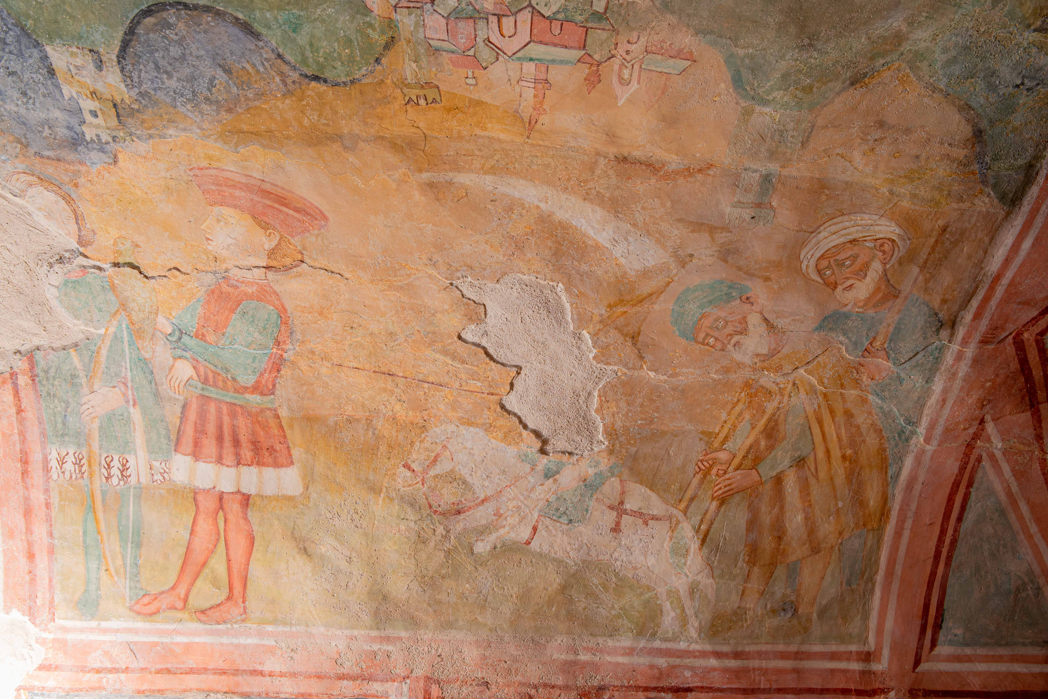

Slide 32
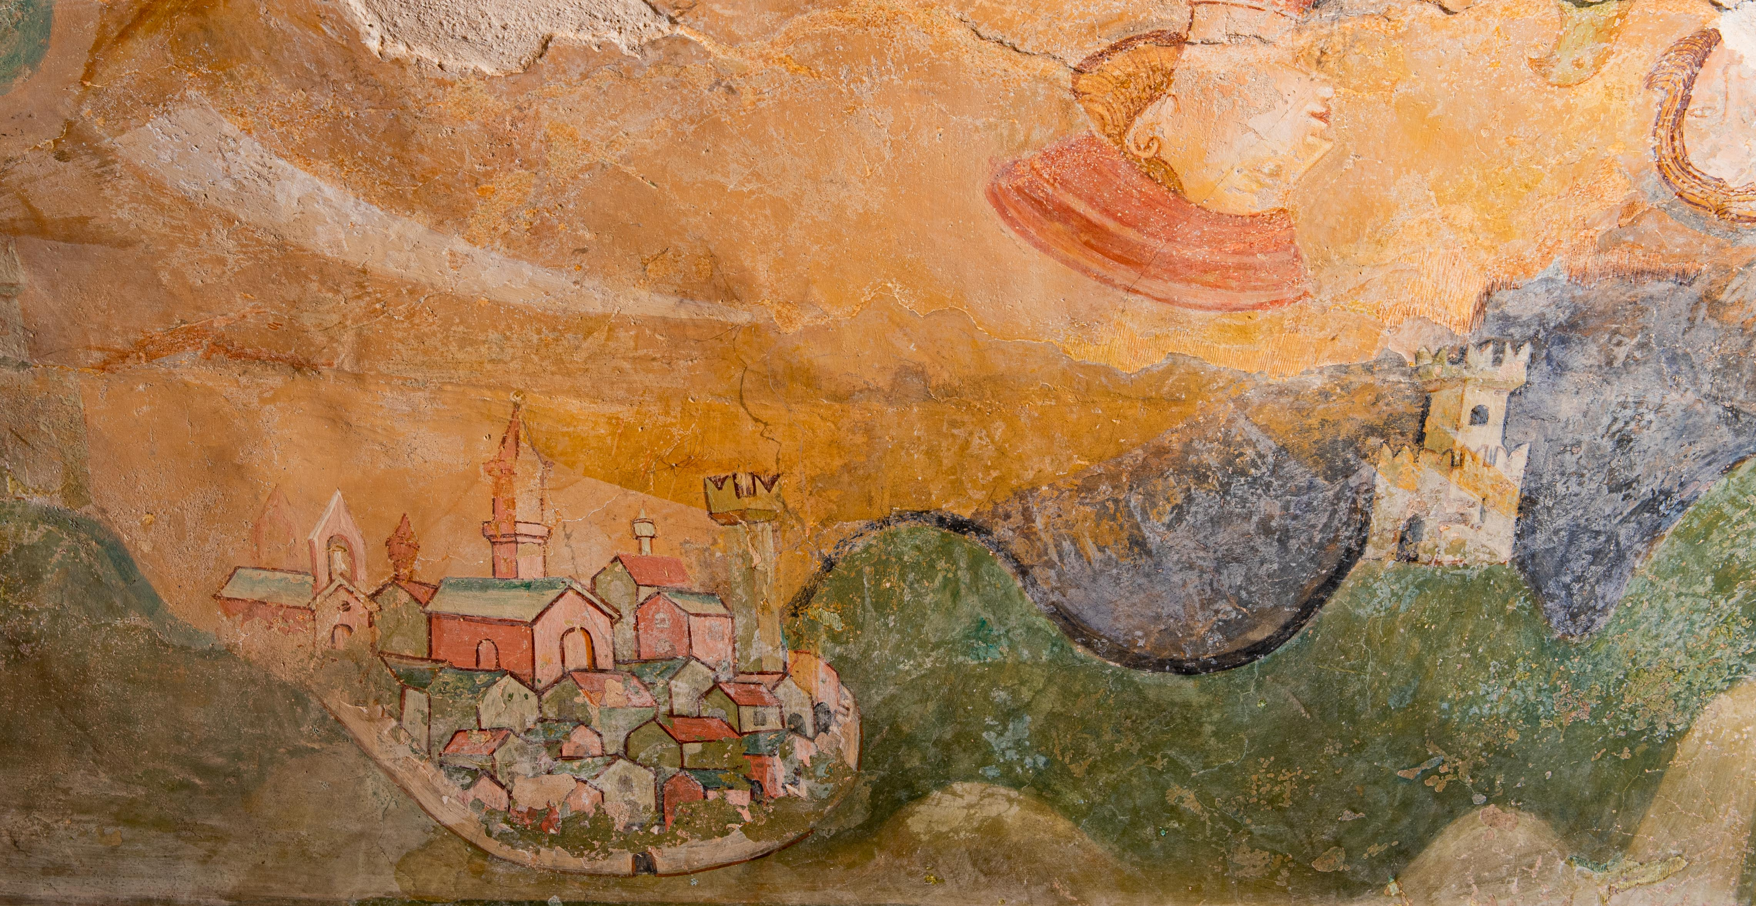
The landscape which forms the background to this message of doom is serene and harmonious. Set among winding routes are towers and little hamlets, undoubtedly, the artist was familiar with the beauty of our territory. It is a countryside with a wealth of noble settlements which, still today, are dotted about on the hills and mountains around Nocera Umbra.

Slide 33
CONCLUSIONS
On completion of the study session students will: Possess sufficient methodological tools to be able to interpret a work of art from a formal, stylistic, iconographical and technical point of view and understand how it relates to the historical, social and cultural environment in which it was produced. Sacred and devotional art as a place where pilgrims and wayfarers could meet and find a welcoming admittance. The ancient pious practice which consisted of travelling collectively or individually to a holy place in order to carry out special acts of devotion with a votive or penitential intent.Students will be able to grasp the principal problems and lines of artistic research connected to these centuries and to recognise and comment on the works of the major artists belonging to the various movements. At the same time, great attention will be given to the material aspect of the art work, its techniques and stylistic features. A fundamental requirement will be to educate the observer in attention to detail, to the expressions of the faces, to the gestures and postures because these are component skills for the appreciation of the richness of non-verbal language.This study activity can be used in distance learning with the assistance of a tutor who is on the staff of the Civic Museum in Nocera Umbra.We hope that a visit to the Art Gallery can take place in person as many of the works in the collection can enrich Art History research into the theme presented.

Slide 34
Progetto realizzato con il Contributo della

