Slide 1
Medusa
EDUCATIONAL ACTIVITY FOR 5TH YEAR OF PRIMARY SCHOOL
LIVE AT THE ARCHAEOLOGICAL MUSEUM IN NOCERA UMBRA OR VIA DISTANCE LEARNING

Slide 2
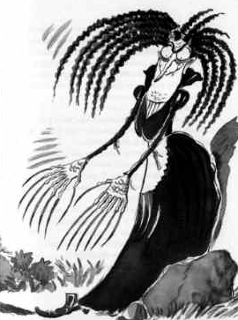
Form: Approaching History through Myth
Who is Medusa?
Pupils will learn, draw, create a mask (see the papier-mâché glossary), assimilate contents, retell the story and invent a comic-strip.
Creative workshop for individuals or groups lasting from 3-5 hrs.

Slide 3
You too can draw a mask of Medusa like this one, then cut it out and colour it or model it in papier-mâché and invent your own story

Slide 4
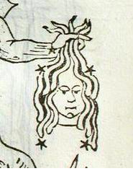
Astronomical Curiosities for further in-depth study
Observing the stars and finding the constellation (astronomical map). Northern hemisphere The HEAD OF MEDUSA: belongs to the constellation known as Perseus, but some ancient astronomers held it to be a separate constellation owing to the well-known variability of the star called Algol, or “the Demon Star”. (Picture from the Poeticon Astronomicon -Poetical Astronomy- by Hyginus, printed in 1482).

Slide 5
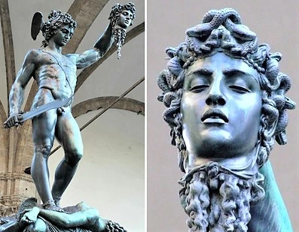
In Piazza della Signoria, in Florence, there is also the bronze statue of Perseus holding the head of Medusa, a wonderful work of art made by Benvenuto Cellini in 1554. It is 3.19m tall and is situated under the Loggia dei Lanzi. The statue of the triumphant Perseus embodies a political allegory as it proclaims the decisive ‘decapitation’ of Republicanism, symbolised by Medusa, carried out by the Medicis. Morover, the snakes on Medusa’s head represent the civic strife which had always undermined real democracy.

Slide 6
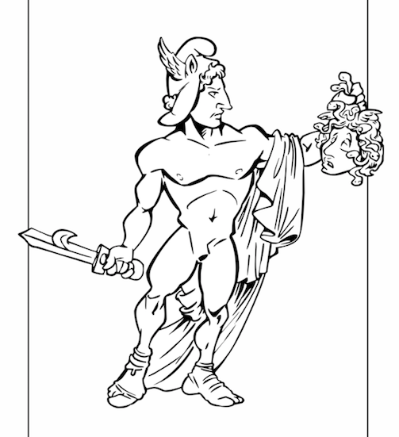
MEDUSA, THE GORGON WITH SERPENTS FOR HAIR
According to legend, Perseus, the Greek hero, son of Zeus and Danae, was thrown into the sea as a new-born baby, together with his mother, inside a wooden chest, on the orders of his grandfather, who wanted to ward off the misfortune which had been prophesised. Perseus, however, survived and, after a series of adventures, he was ready to carry out the deed for which he is famous: beheading Medusa, one of the three Gorgon sisters, who was their queen and guardian of the Underworld.
Perseus was aided in this enterprise by the deities, Hermes and Athena, who convinced the Naiads, important figures in Greek mythology, to transform Perseus into a super-hero by giving him a pair of winged sandals so that he could fly, a helmet which rendered him invisible, and a leather bag in which to put the Gorgon’s head. Perseus accomplished the task and cut off Medusa’s head.

Slide 7
Medusa before she had been cursed
Although Hesiod gives an account of Medusa’s origins and of her death at the hands of Perseus, he says very little else about her. On the other hand, one can find a more complete narrative about Medusa in the ‘Metamorphoses’ by the later poet, Ovid (43BCE – 17/18 CE). In Ovid’s version, Medusa was originally a beautiful young girl. Her beauty attracted the attention of the god of the sea, Poseidon, who desired her and possessed her in the sanctuary of Athena, goddess of Art, Wisdom and War. The goddess avenged this insult by transforming Medusa’s hair into serpents so that anyone who looked directly at her would be turned to stone. ‘Metamorphoses’ IV, ll.793-803, “ In order that the snake-haired head should not suffer any damage in the sand, (anguiferumque caput dura ne laedat harena), he makes the ground softer with a layer of leaves, then, on top of them, spreads some water-born reeds and thereon places Medusa’s head face downwards”.

Slide 8
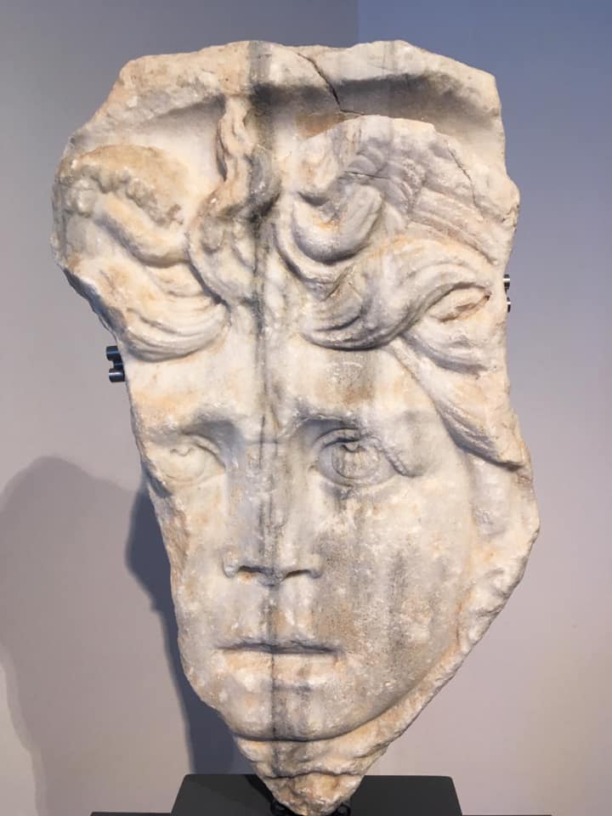
Head of Medusa, carving from a Roman sarcophagus. 3rd century CE Archaeological Museum, Nocera Umbra.

Slide 9
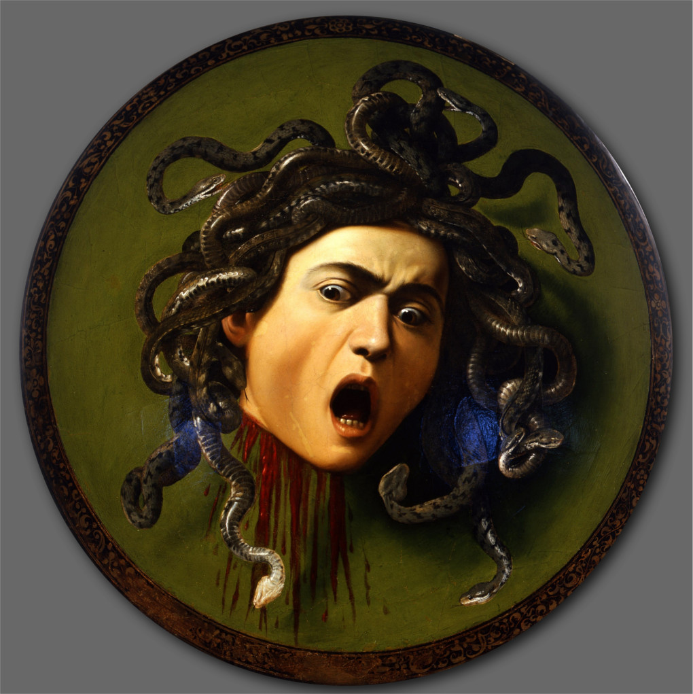
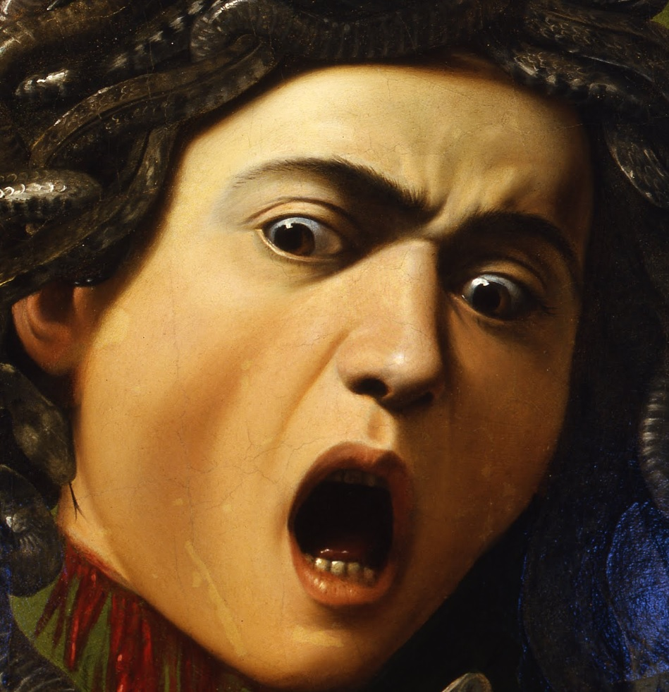
This work by Caravaggio, dating from 1596, was commissioned by Cardinal del Monte who wished to make a gift of it to Ferdinand I of the Medicis. It reproduces a ceremonial shield and consists of a wood panel base covered in canvas and painted in oils. For a long time it was on display in the Medici armoury alongside other pieces of ostentatious armour. The iconographic image of Medusa is conveyed here by the artist in the form of a self-portrait with grossly deformed features, just as Medusa is described as having in the legend. Uffizi Gallery, Florence. Caravaggio, oil on fig wood measuring 55x60 cm.

Slide 10
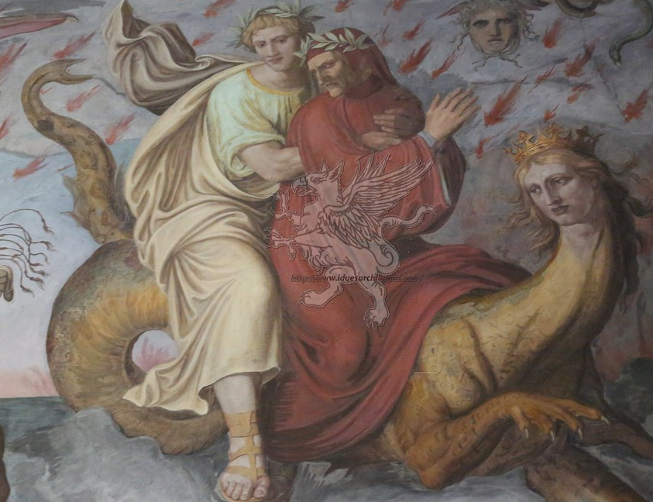
Dante and Virgil struggling against the mythical monsters who are intended to strike a chord of terror, introduction to the 1st Canto of the ‘Inferno’. Fresco from the literary Dantesque cycle painted by artists of the Nazarene movement in the hunting lodge of Prince Giustiniani in Rome. Painters Philipp Veit and Joseph Anton Koch (1818-1828)

Slide 11
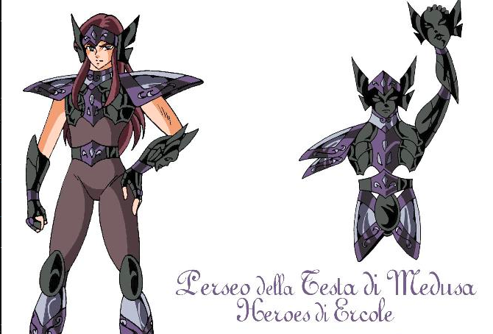
MYTH, ART, HISTORY
YESTERDAY AND TODAY
Cartoon
Grafic design

Slide 12
Glossary: Papier-mâché is an artistic technique which employs paper or rags soaked in vinyl glue or wallpaper paste. Nowadays, this technique is principally employed during the Carnival period for use on the floats and to make Carnival masks. It is a very ‘green’ technique as it is an excellent way of recycling waste paper. It has very remote origins; it seems that the first people to use it were the Ancient Greeks, who, instead of paper, used linen fibres. In Italy, the technique has been in use since the 15th century, being employed to manufacture devotional statues or preparatory models. Great artists like Michelangelo and Donatello used precisely this technique in order to create their preparatory models.
Teachers are advised to study the artistic techniques in greater detail using the internet as an aid.

