Slide 1
With the contribution of Regione Umbria
Educational workshop by
Palazzo dei Consoli Civic Museum, Gubbio

Slide 2
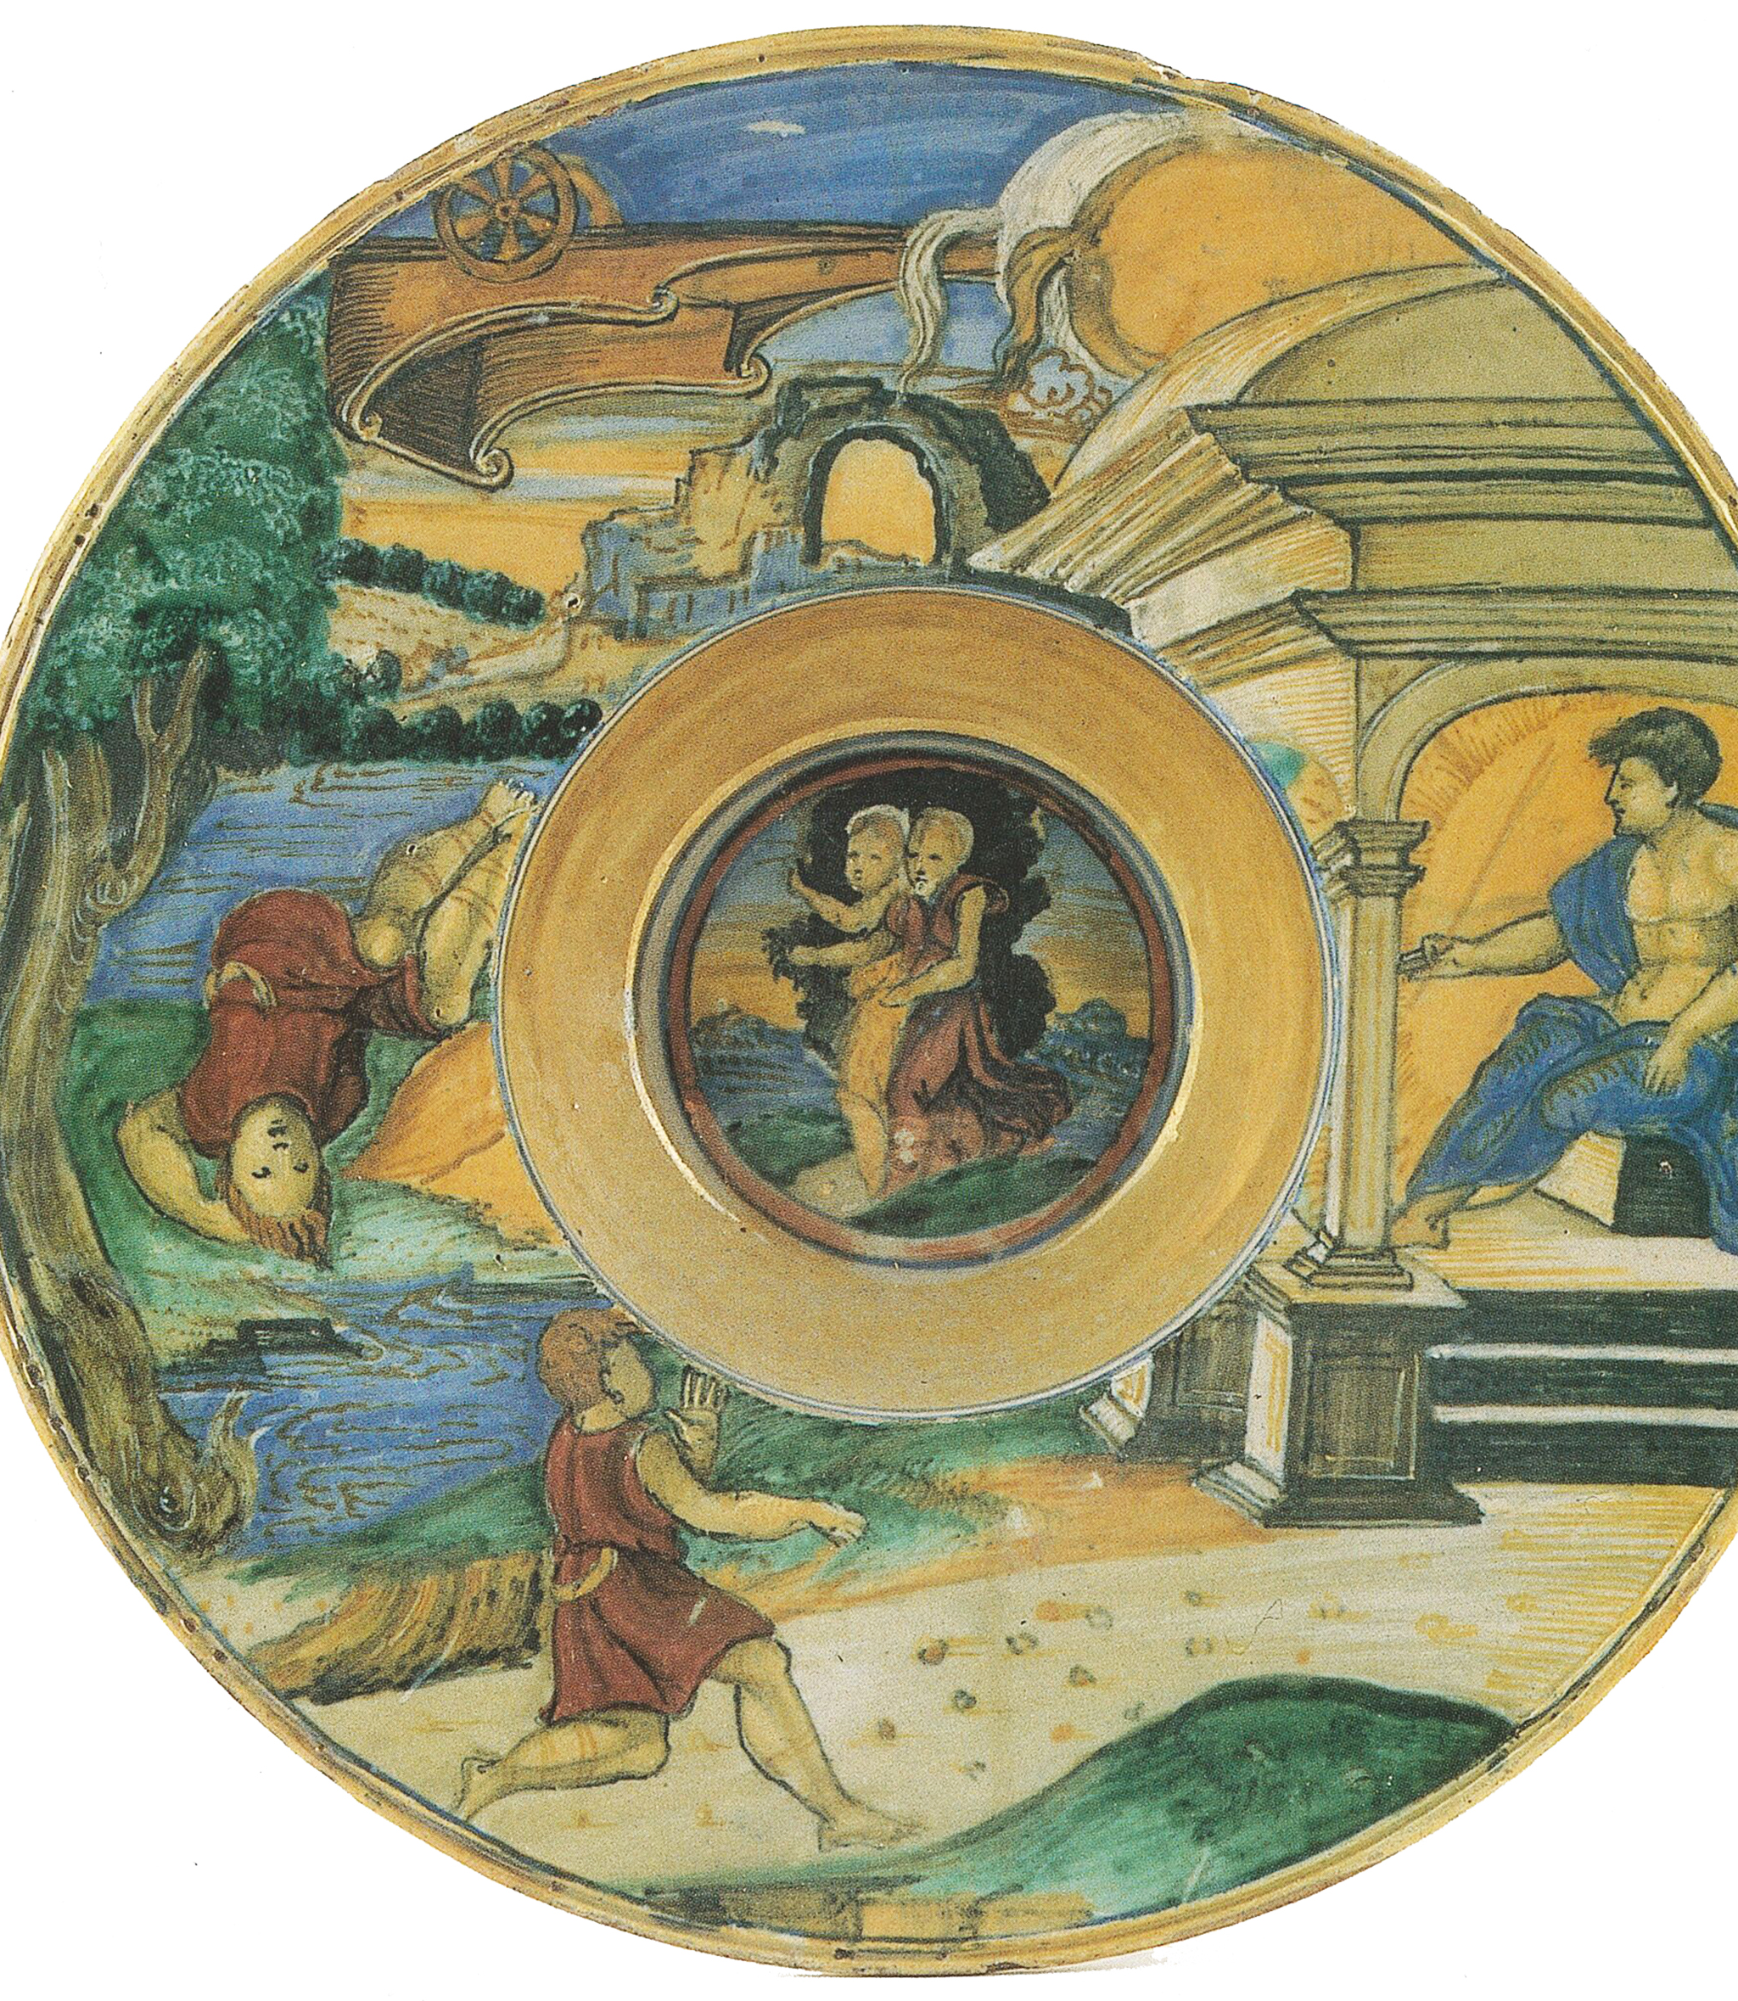
A mythical story to decorate

Slide 3
REQUIRED MATERIALS
A round cardboard base for cakes 20 cm wide. Alternatively you can cut one from the drawing sheet.
Pencil
Scissors
Vinyl glue or stick
A small paint brush
Golden and red glitter glue
Image of the historiated dish

Slide 4
Cut - out the image of the historiated dish along the contour

Slide 5
Paste the cutted-out image onto the cardboard base

Slide 6
If you use vinyl glue you can spread it on the cardboard with the paint brush

Slide 7
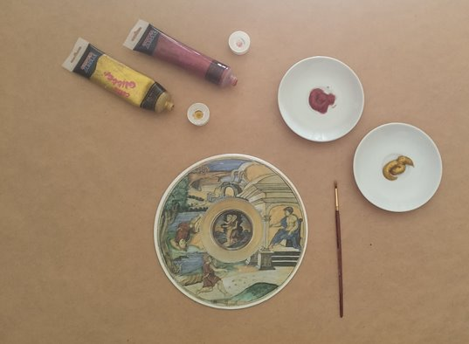
Pour the red and golden glitter glue in two jars
Spread the colour with the paint brush

Slide 8
Decorate the image to imitate the presciousness and brightness of the luster colours of Mastro Giorgio....Golden yellow and ruby red

Slide 9
Use the golden colour for the outer edge of the dish.... For the large yellow circle in the center... For reflections in the river water...

Slide 10
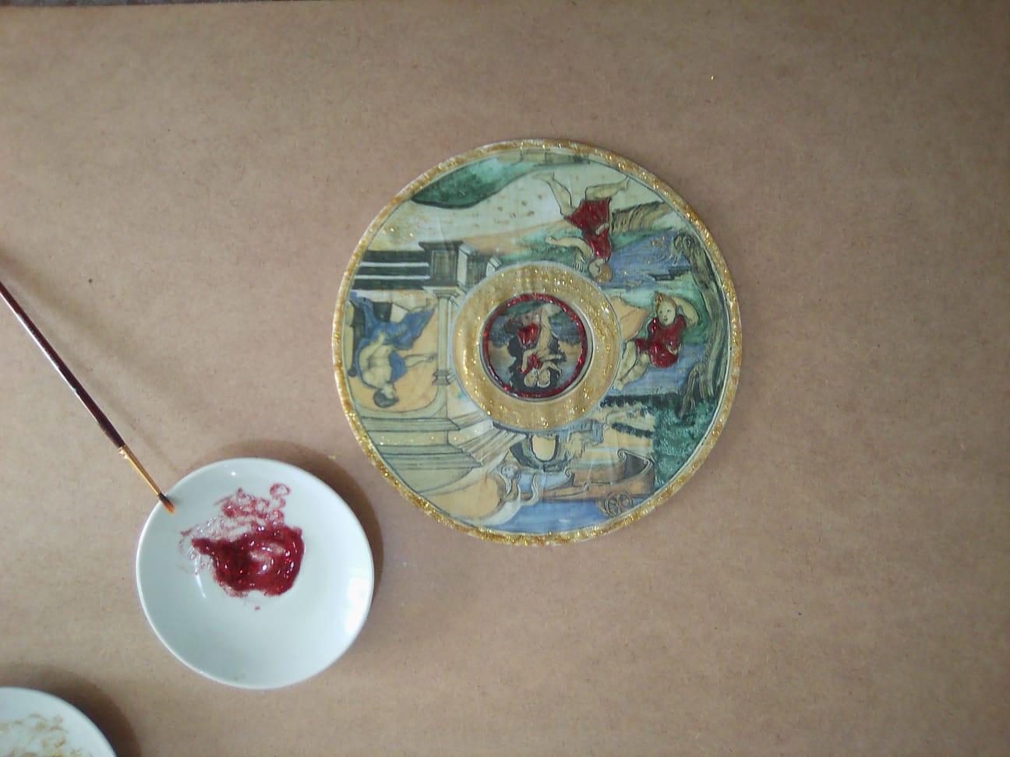
Use the red colour for the robe and hair of Phaethon.... For the thin circle in the center of the dish... For one of the two figures embraced at the tree...

Slide 11
The artwork has been completed....a mythical and shining story You just have to dry the colours and write your name and the date on the back of the work!

Slide 12
© Copyright – All rights reserved

