Slide 1
The archaeologist and historical sources
Educational activity for primary school:
class I, II, III.
ARCHEOLOGIC MUSEUM OF NOCERA UMBRA

Slide 2
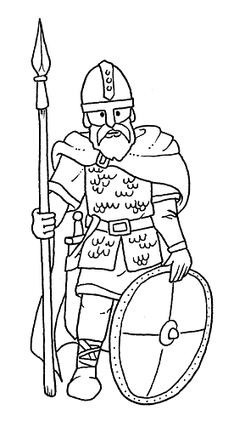
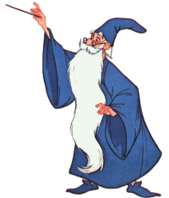
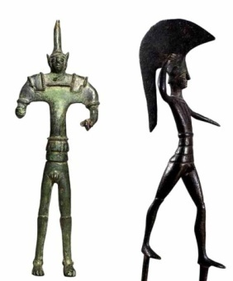
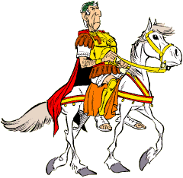
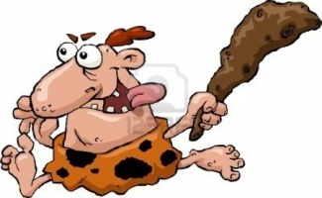
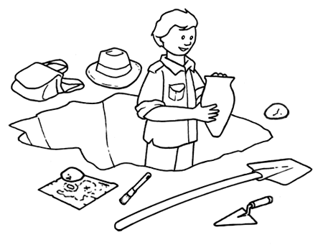
TIME LINE
PREHISTORY
ANCIENT ROME
MIDDLE AGES
AGE OF METALS
LONGOBARDS
800.000
anni fa
3.500 a.C.
783 a.C.
476 d.C.
568 d.C.
774 d.C.
Fino al 1492
oggi
0

Slide 3

WHAT IS
ARCHEOLOGY?

Slide 4

FROM THE ANCIENT GREEK LANGUAGE
ἀρχαιολογία
ἀρχαῖος,
"antico”
λόγος,
"discorso" o "studio”

Slide 5

ARCHAEOLOGY DEALS WITH THE RECONSTRUCTION OF ANCIENT SOCIETIES, THROUGH THE COLLECTION,
THE DOCUMENTATION AND ANALYSIS OF THE MATERIAL TRACES THAT HAVE LEFT, AS FOR EXAMPLE, ARCHITECTURE, MANUFACTURED AND HUMAN REMAINS.
ORAL SOURCES
ICONOGRAPHIC SOURCES
WRITTEN SOURCES
ARCHAEOLOGICAL SOURCES

Slide 6
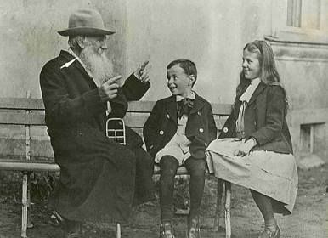
Oral sources

Slide 7
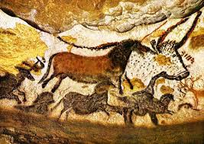
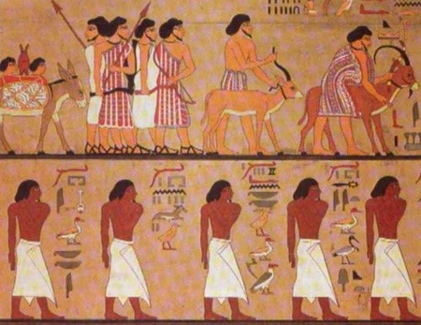
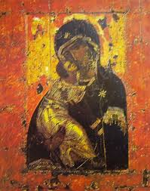
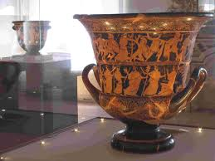
Iconographic sources

Slide 8
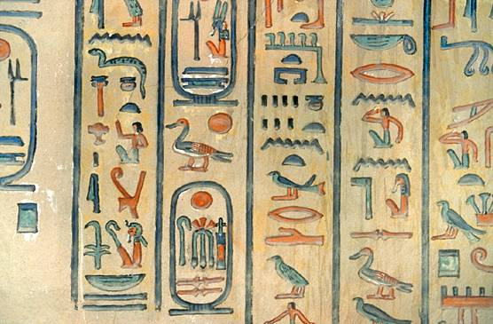
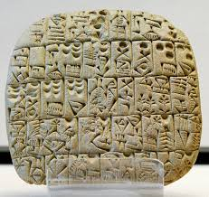
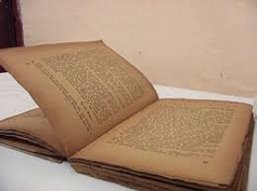
Written sources

Slide 9
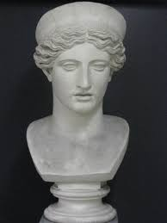
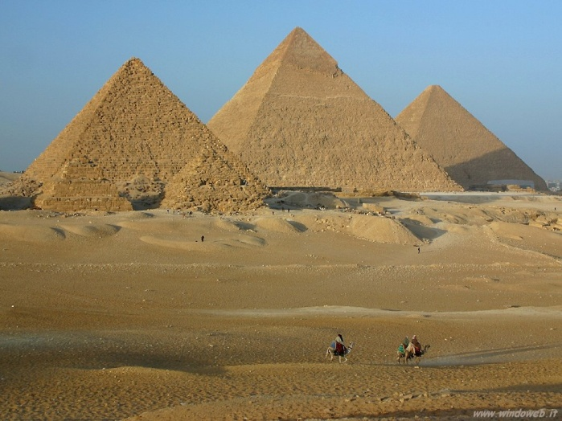
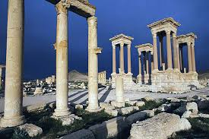
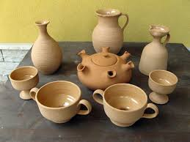
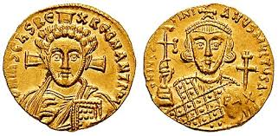
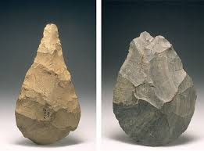
Archaeologic sources

Slide 10
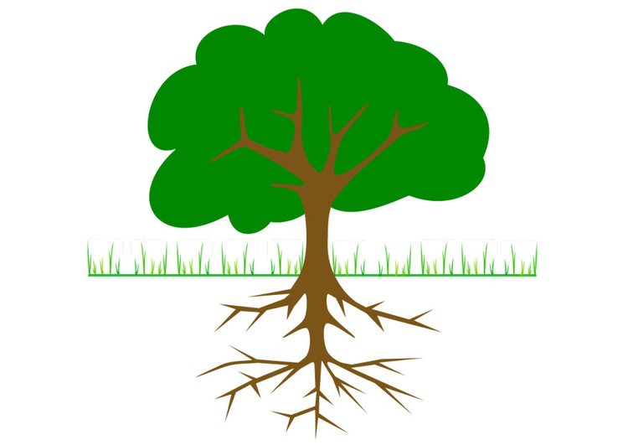
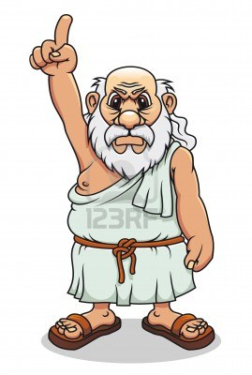
Why underground?

Slide 11
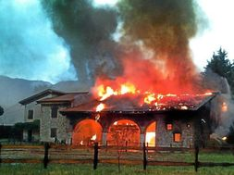


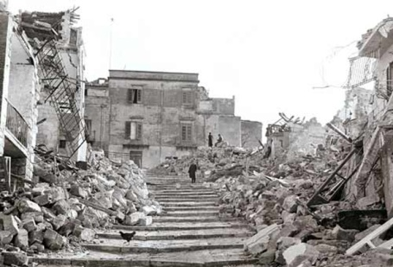
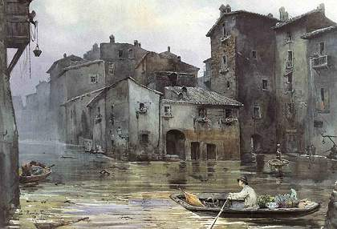
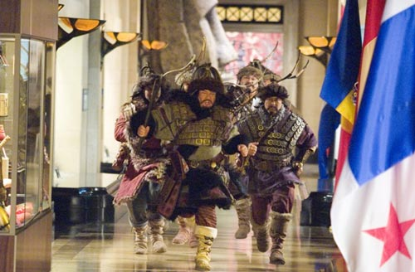

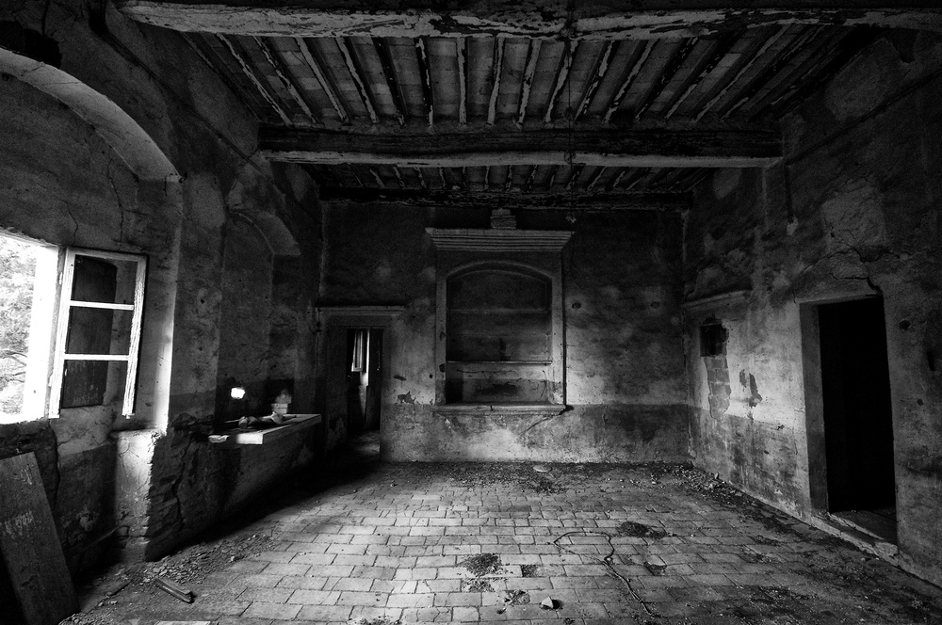

Slide 12
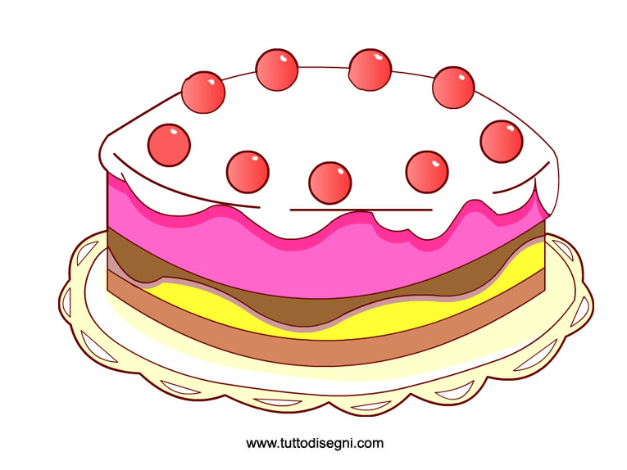
TELL
It is a type of archaeological site.
The result of the accumulation and subsequent erosion of materials deposited by human occupation over long periods of time
TELL
View in section

Slide 13
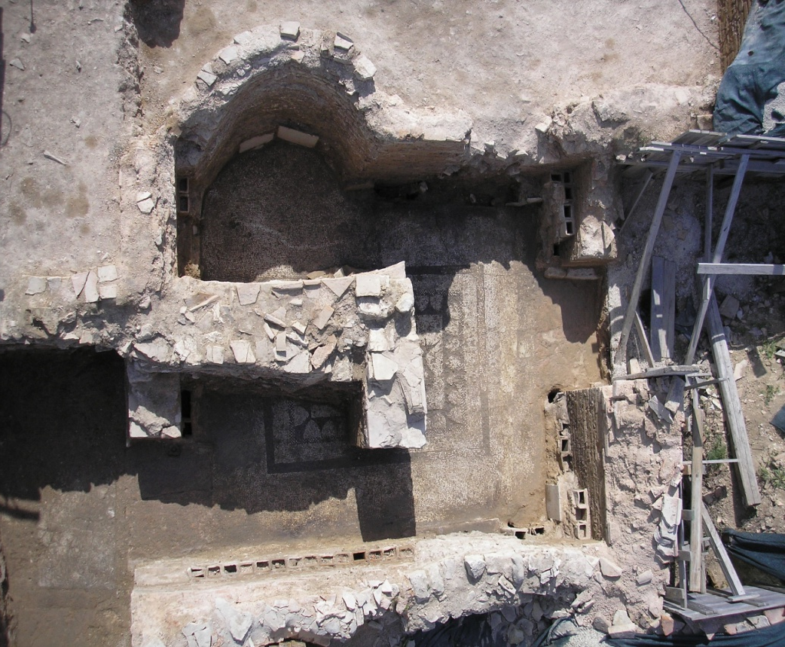
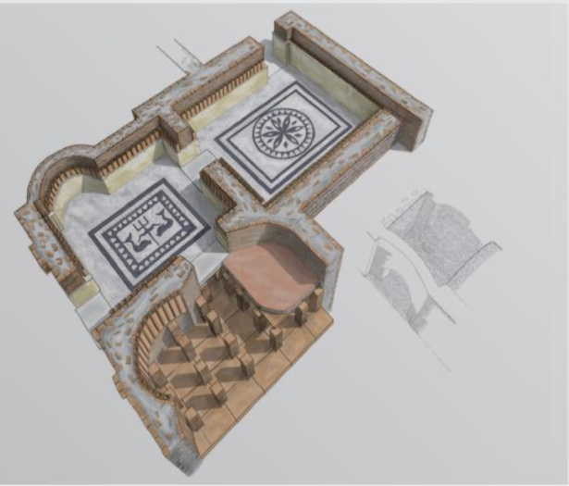
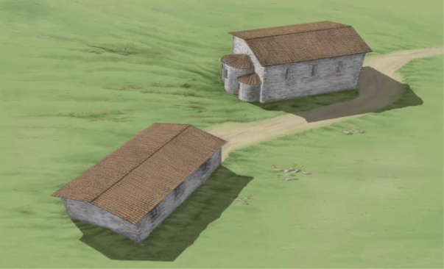
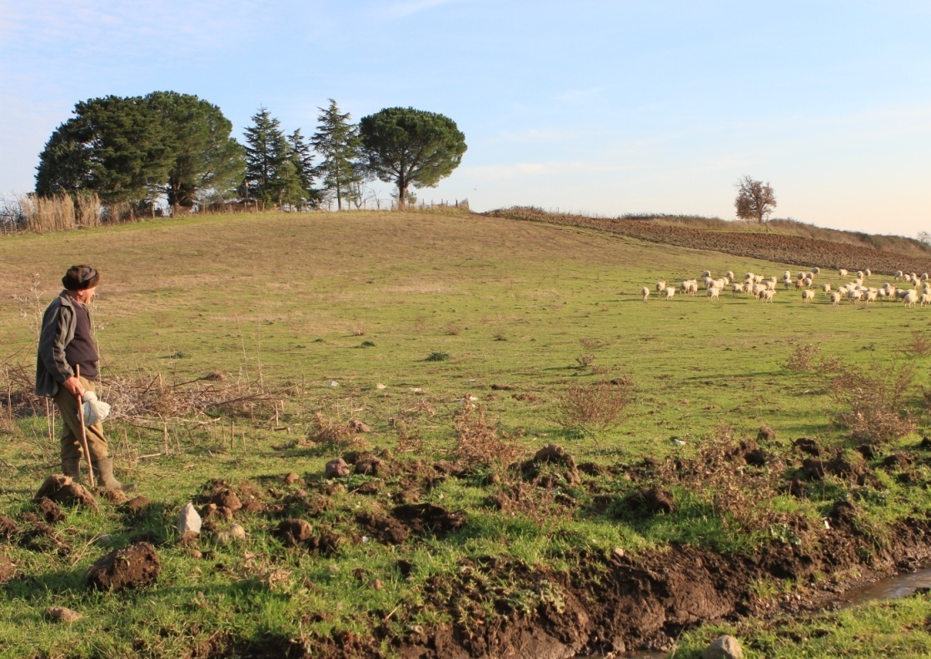
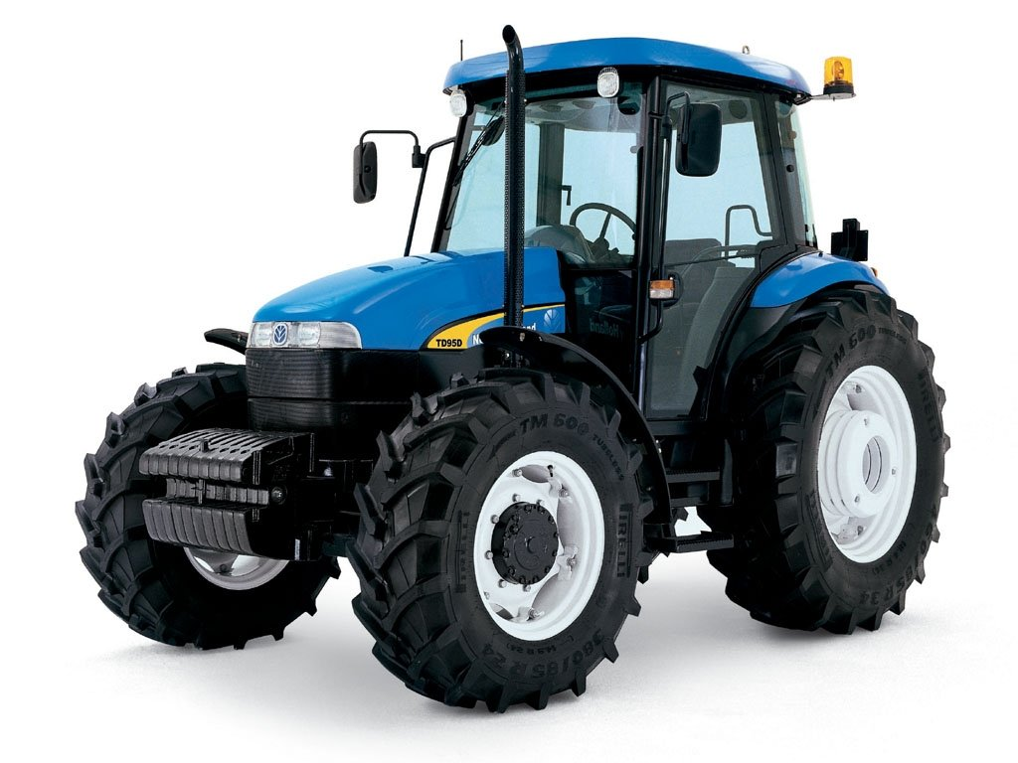
LA VILLA ROMANA CON I MOSAICI
I SECOLO DOPO CRISTO
I GOTI, TOTILA E L’ACCAMPAMENTO
530 – 553 DOPO CRISTO
LA CHIESA LONGOBARDA
700 – 900 DOPO CRISTO

Slide 14

STRATIGRAPHIC SUCCESSION

Slide 15
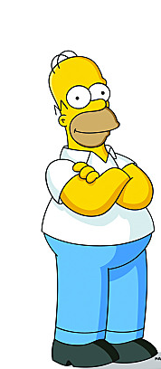
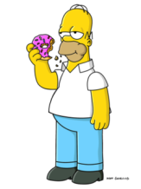
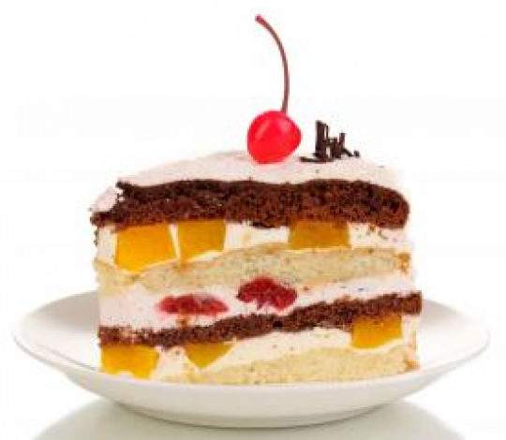
STRATIGRAPHIC SUCCESSION
U.S. 0
U.S. 1
U.S. 2
U.S . 3
U.S. 4
U.S. 5
STRATIGRAPHIC UNITS “U.S.”

Slide 16
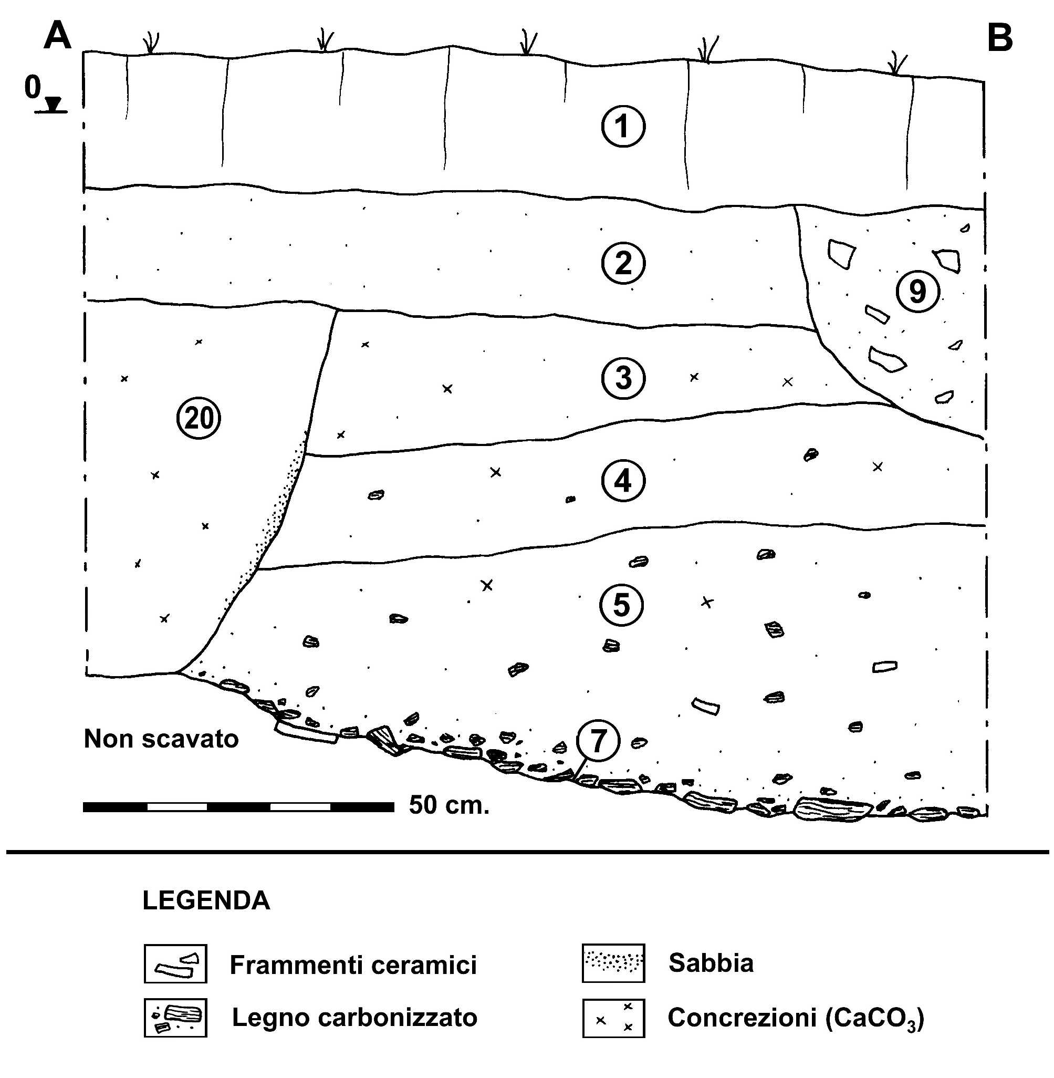


Slide 17
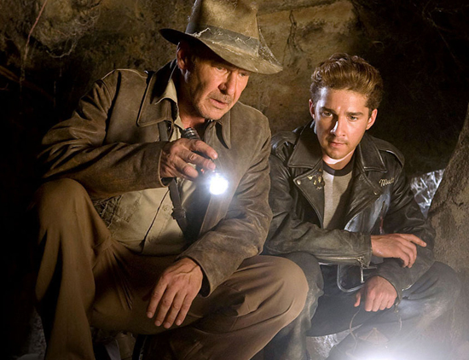
THE ARCHAEOLOGIST …..

Slide 18
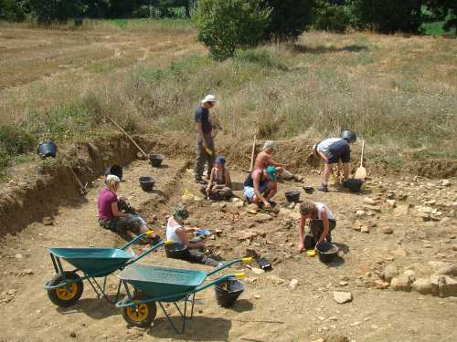
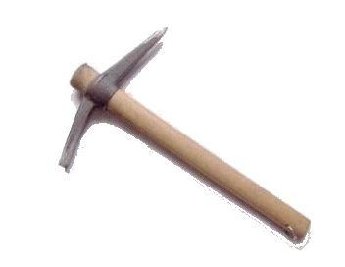
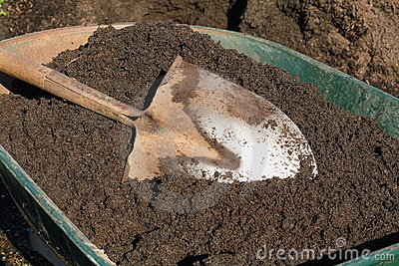
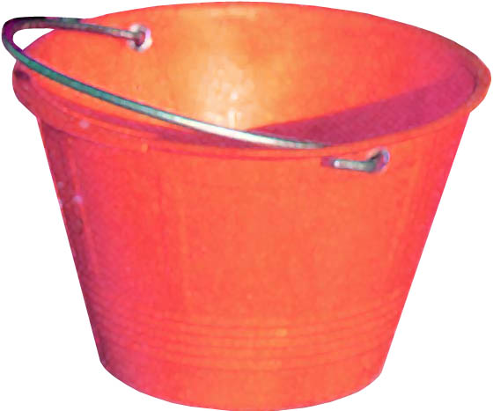
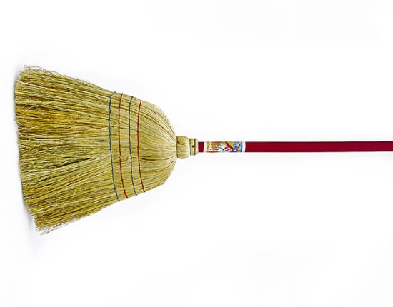
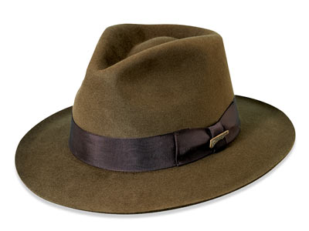
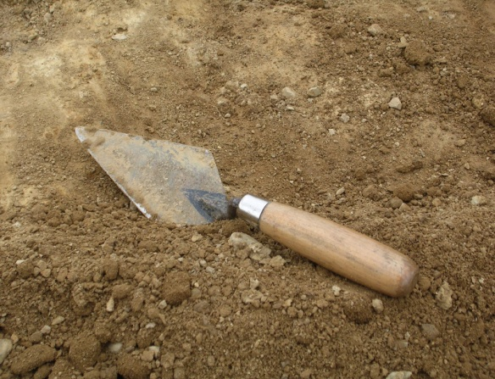


Slide 19
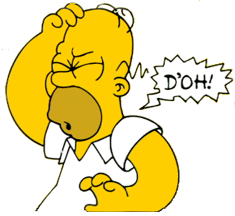
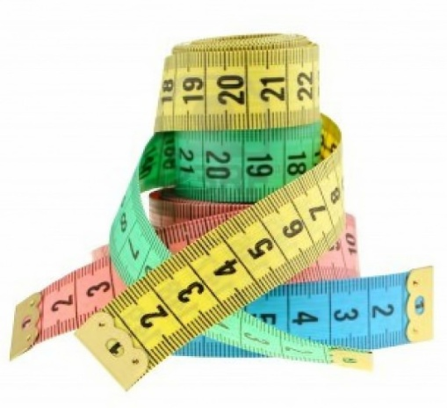
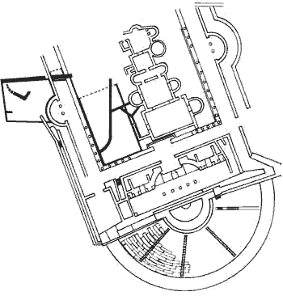
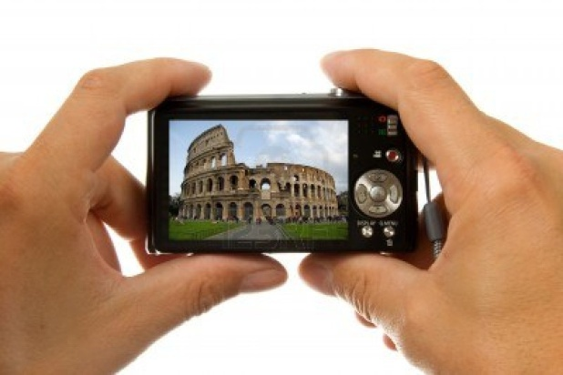
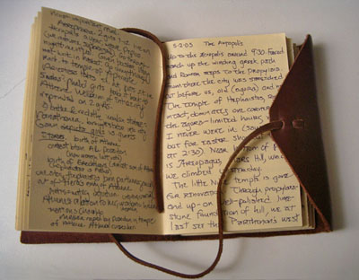
THE ARCHAEOLOGICAL EXCAVATION IS AN IRREVERSIBLE OPERATION !!!!
Each layer of earth that is removed is like a layer of cake that is eaten …….
THE ARCHAEOLOGIST MUST DOCUMENT EVERYTHING !!!!

Slide 20
WHAT IS AN ARCHAEOLOGICAL PLANT?

Slide 21


Slide 22
3 x 3 metri

Slide 23


Slide 24
THE WORK OF THE ARCHAEOLOGIST
1) STUDY THE SOURCES (KNOW MANY TYPES OF CAKES !!)
2) DIG IN A STRATIGRAPHIC WAY (REMOVE A LAYER OF CAKE AT A TIME)
3) PHOTOGRAPH, MEASURE AND DRAW EVERY LAYER (BEFORE EATING IT)
4) COLLECT ALL THE ARCHAEOLOGICAL FINDS YOU FIND IN EVERY LAYER, STUDY AND MAKE SURE THEY ARE TAKEN TO THE MUSEUM

Slide 25


Slide 26



Progetto realizzato con il Contributo della

