Slide 1
FRANCIS AND BROTHER WOLF
ICONOGRAPHY OF A SAINT THROUGH GRAPHIC WORKS

Slide 2
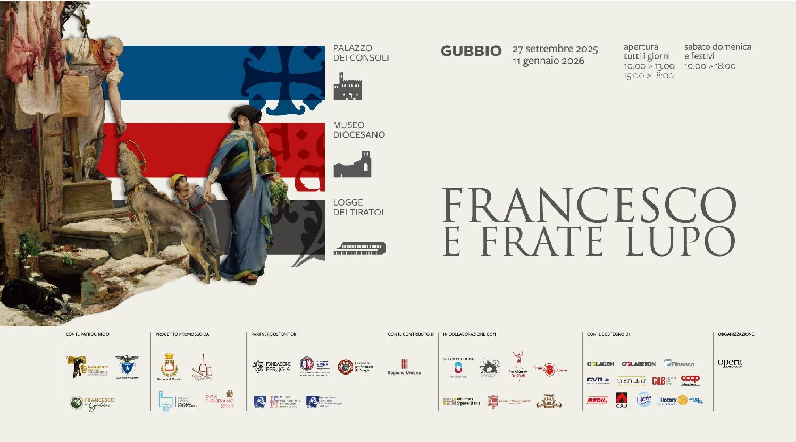

Slide 3
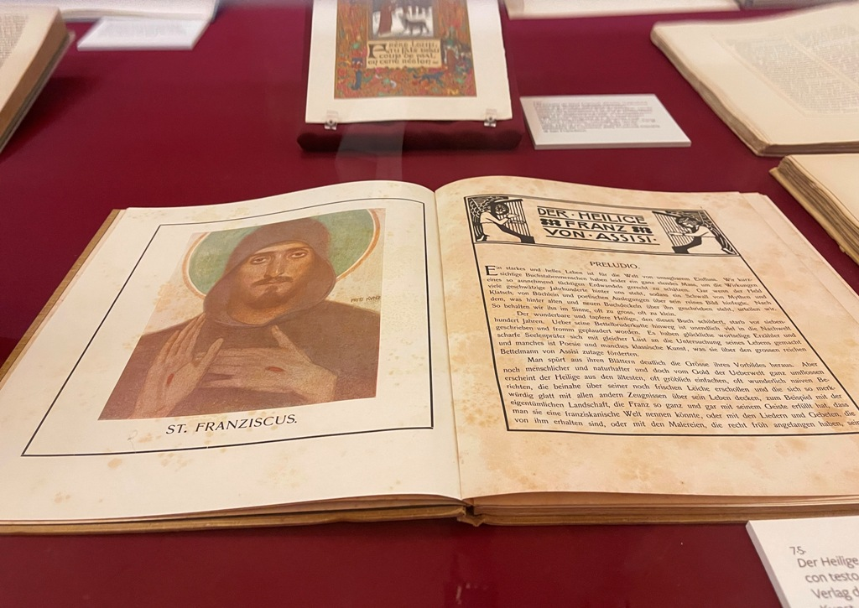

Slide 4
The history of the postcard began in 1869 in Austria, from an idea by Emanuel Herrmann, as a low‑cost means for brief communications; it quickly evolved from simple pre‑stamped cards (in Italy from 1873) into illustrated postcards, which became a fashionable phenomenon in the late nineteenth century, spreading images of places, greetings and affections, and later taking on roles in propaganda, especially during the Great War.

Slide 5
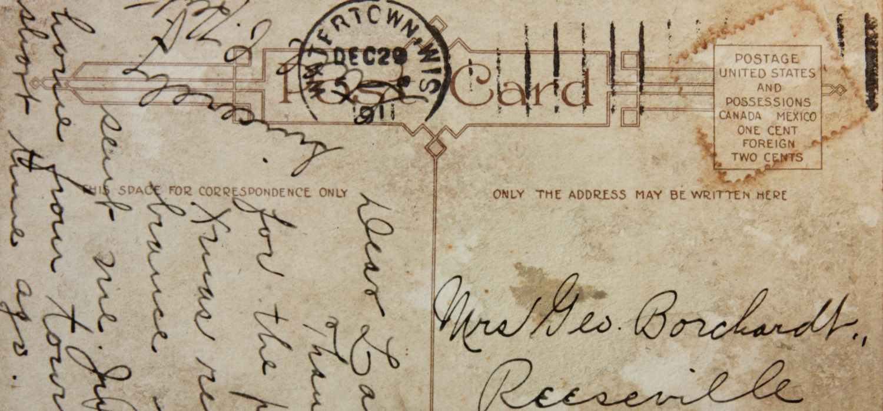

Slide 6
The Explosion of Illustrated Postcards (Late 19th Century - Early 20th Century)
Spread: Postcards were soon accompanied by illustrated ones, produced by private individuals and publishers, becoming a symbol of travel and connection.
Techniques: Lithography and phototype printing became widespread, faithfully reproducing images of tourist destinations (landscapes, costumes, cities) and everyday scenes.
Variations: Christmas cards were created in England, and in 1902, Great Britain introduced the divided-back (the line separating the message from the address), giving rise to the modern postcard, which was internationally recognized in 1907..

Slide 7
In the Last Two Decades of the 20th Century, the foundations of postcards began to falter, partly due to the revolution in communication methods. The arrival of cell phones and emails replaced the traditional postcard with more practical digital messages. The smartphone cameras and mobile data connection then did the rest, permanently changing their role.

Slide 8
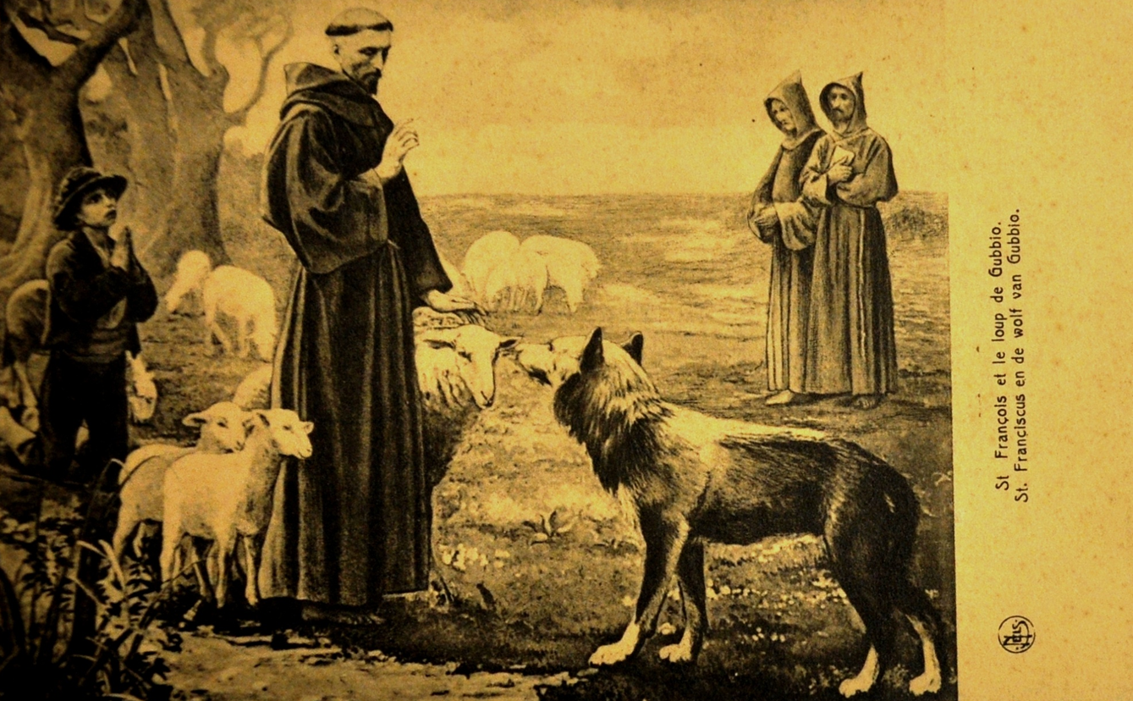
SAINT FRANCIS IN POSTCARDS

Slide 9
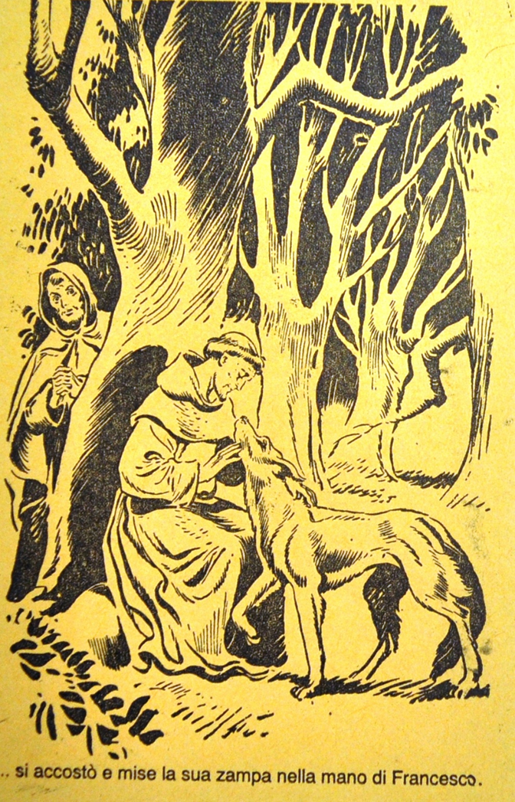
SAINT FRANCIS IN POSTCARDS

Slide 10
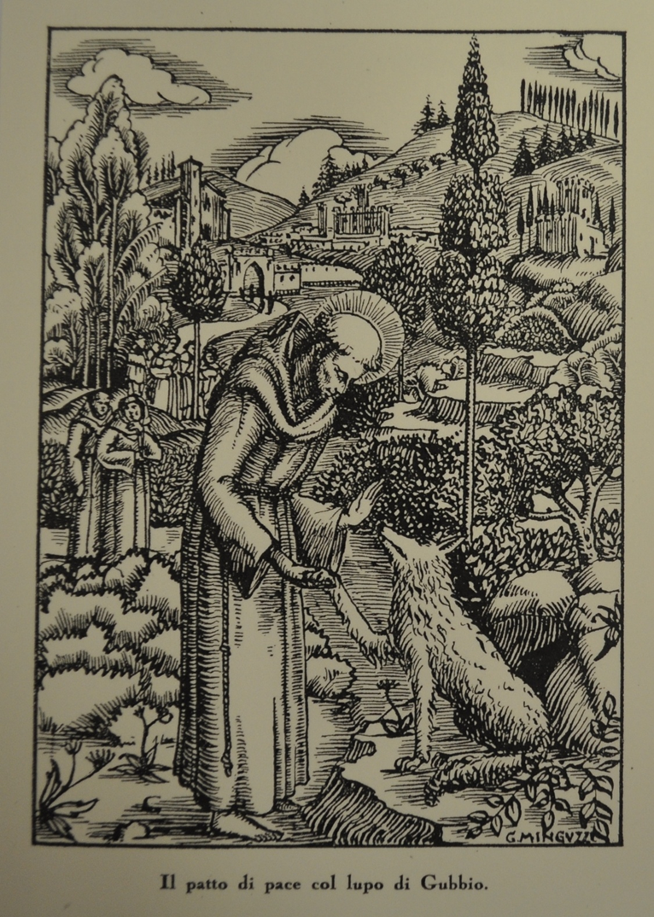
SAINT FRANCIS IN POSTCARDS

Slide 11
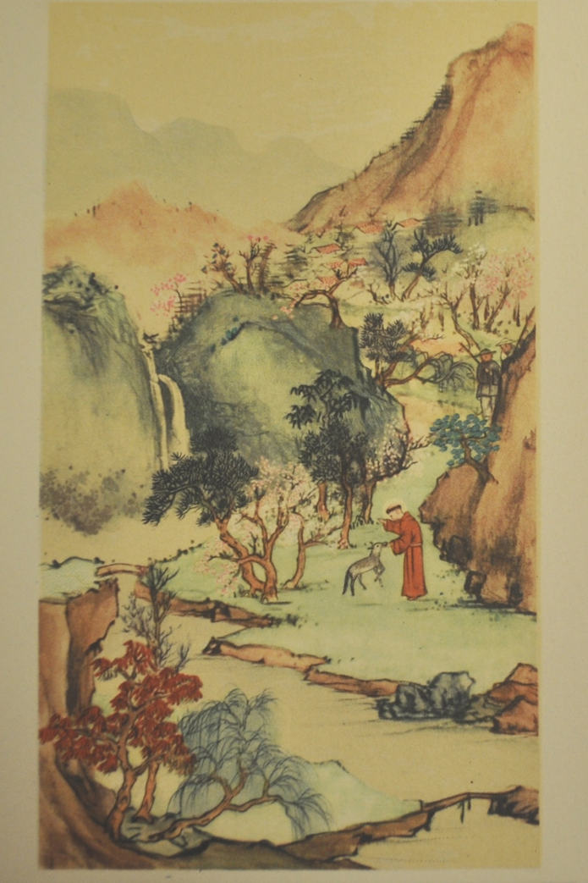
SAINT FRANCIS IN POSTCARDS

Slide 12
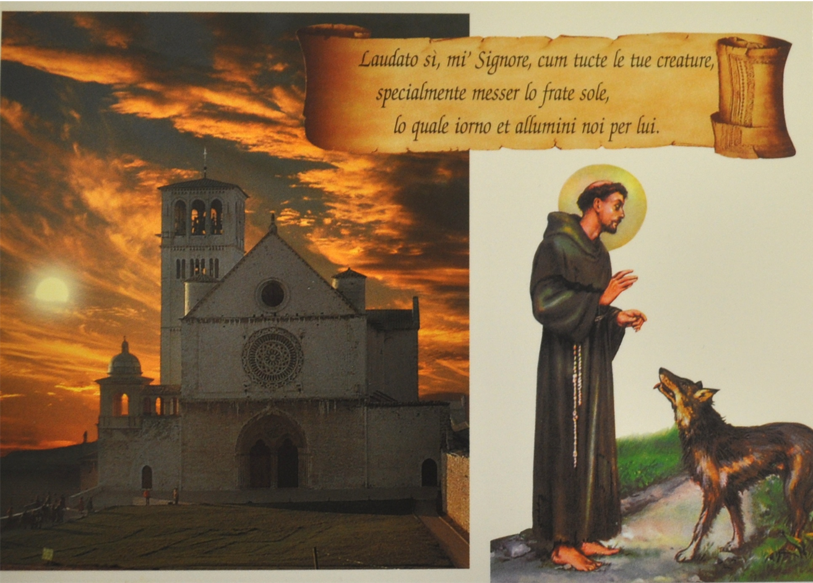
SAINT FRANCIS IN POSTCARDS

Slide 13
OUR LAB
Dear Students,We have prepared a kit for you to create your very own postcard dedicated to Saint Francis and the Wolf. After viewing the postcards on display, feel free to express yourselves stylistically and creatively. Represent Francis and the Wolf through your own critical eye and open heart.Take this opportunity to explore the story of Saint Francis and his connection with nature, particularly the iconic moment of peace with the wolf of Gubbio. Allow your emotions and imagination to guide your artistic choices. Whether you depict a serene, harmonious scene or something more symbolic or abstract, the goal is to reflect the spirit of Saint Francis’s humility, compassion, and deep connection with the world around him.Feel free to use any medium that inspires you, and don’t be afraid to experiment with colors, textures, and perspectives. Let your creativity shine as you bring this beautiful and timeless story to life in your own unique way.

Slide 14
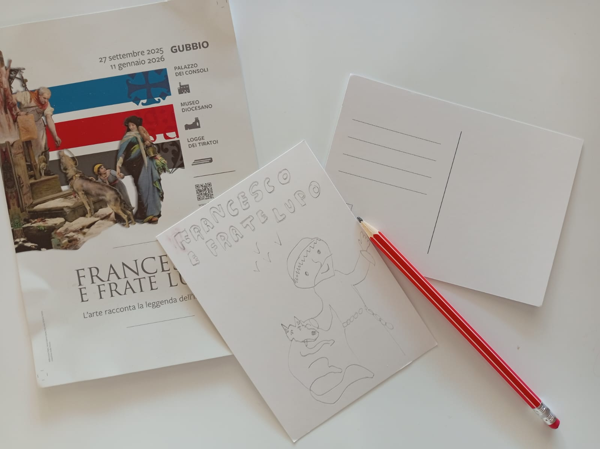

Slide 15
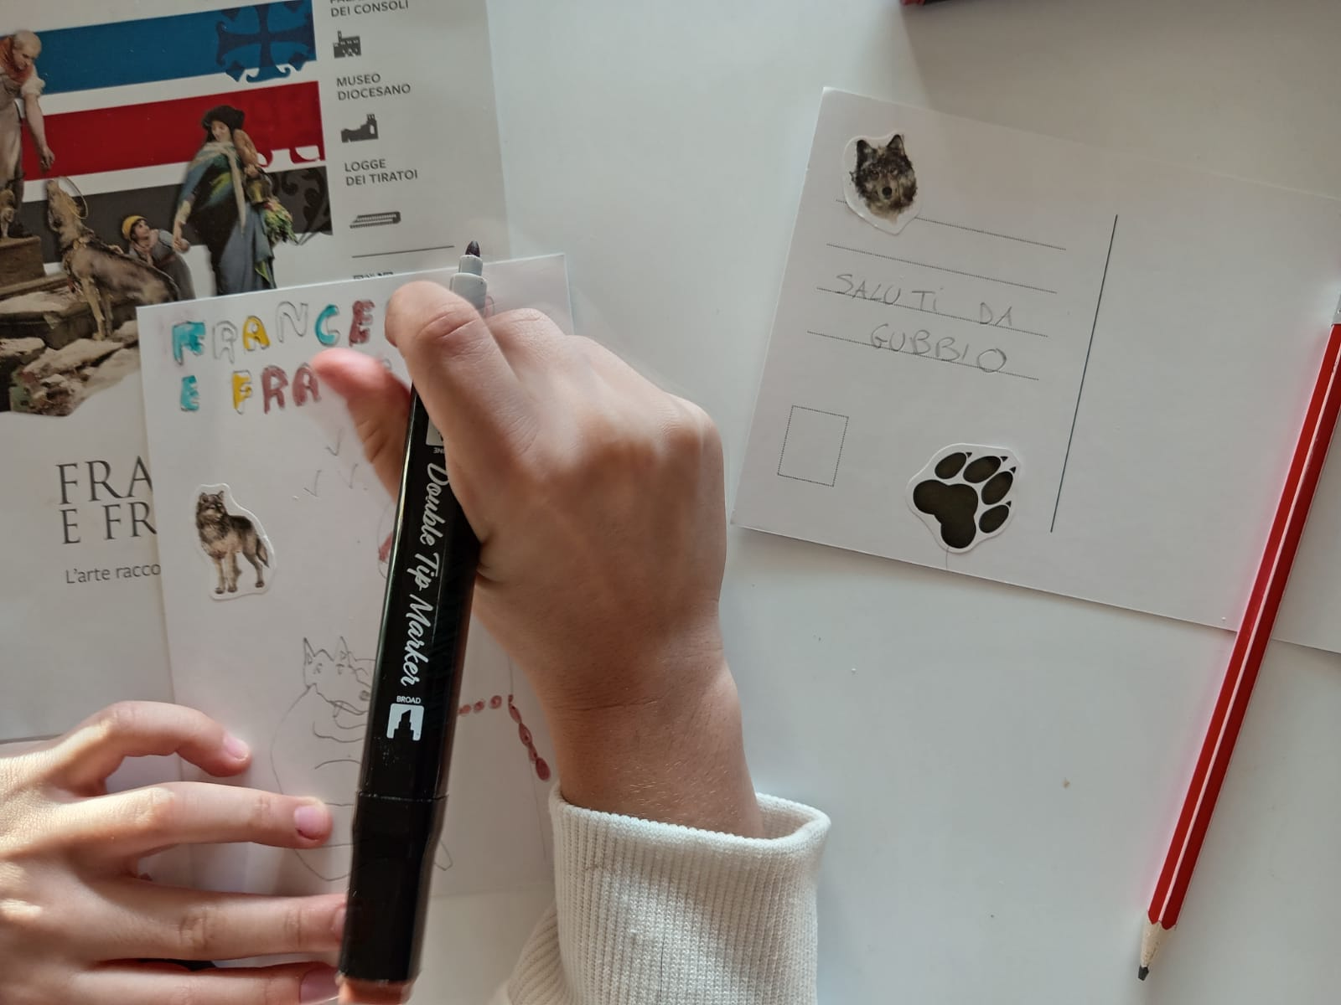

Slide 16
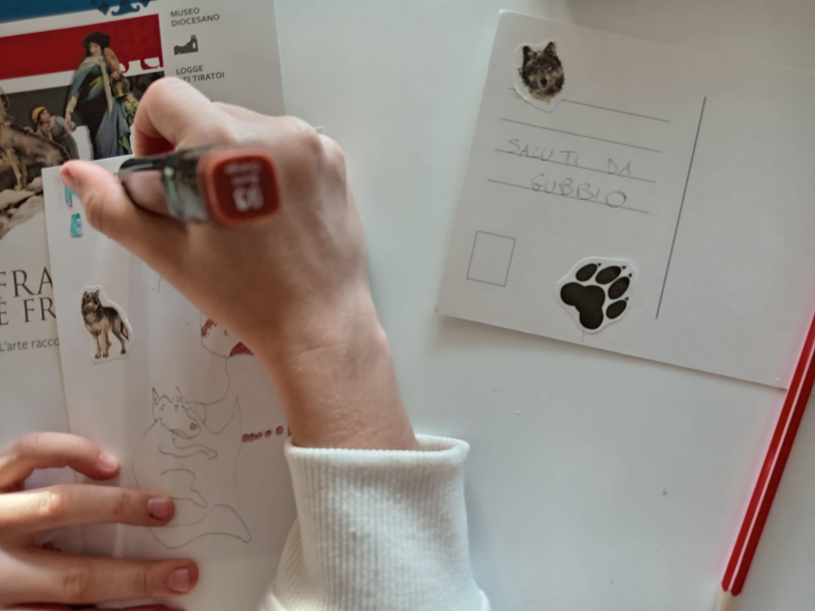

Slide 17
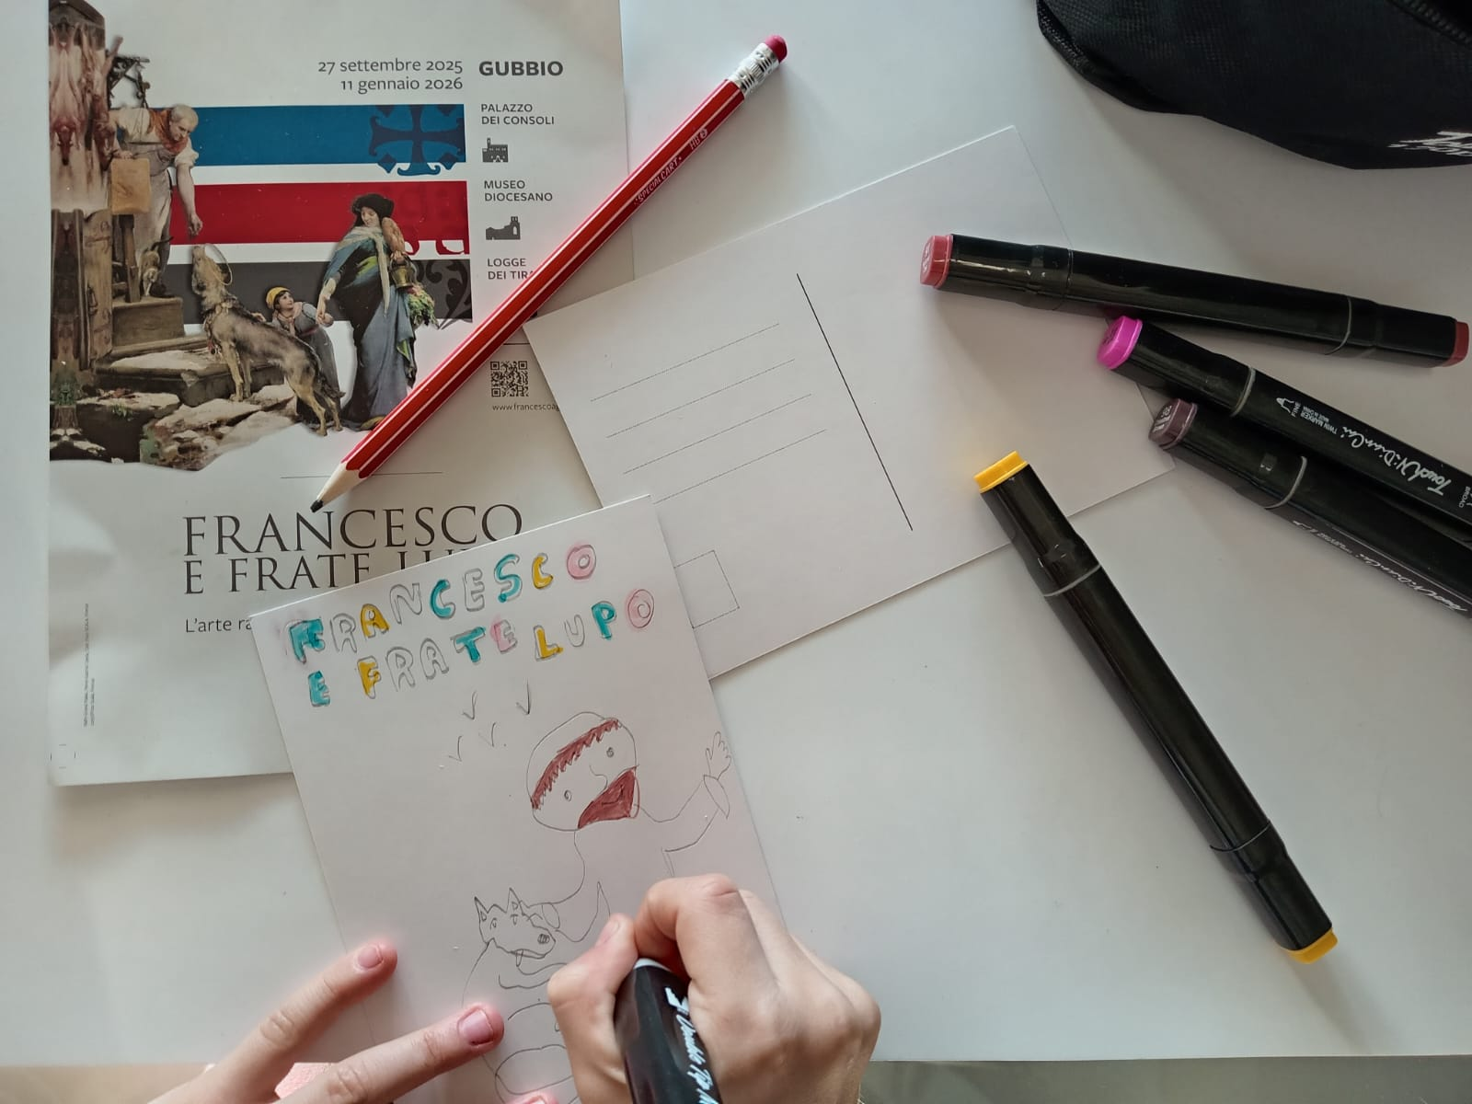

Slide 18


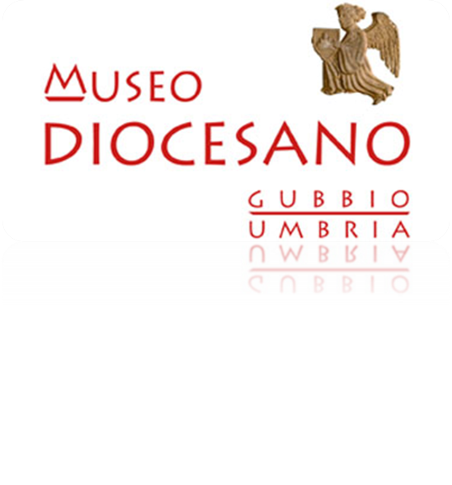
ASSOCIAZIONE CULTURALE LA MEDUSA DIOCESAN MUSEUM OF GUBBIO

Slide 19

MADE WITH THE CONTRIBUTION OF THE UMBRIA REGION

