Slide 1
THE PARCHMENT OF SAINT FRANCIS
PARCHMENT CREATION WORKSHOP INSPIRED BY SAINT FRANCIS

Slide 2
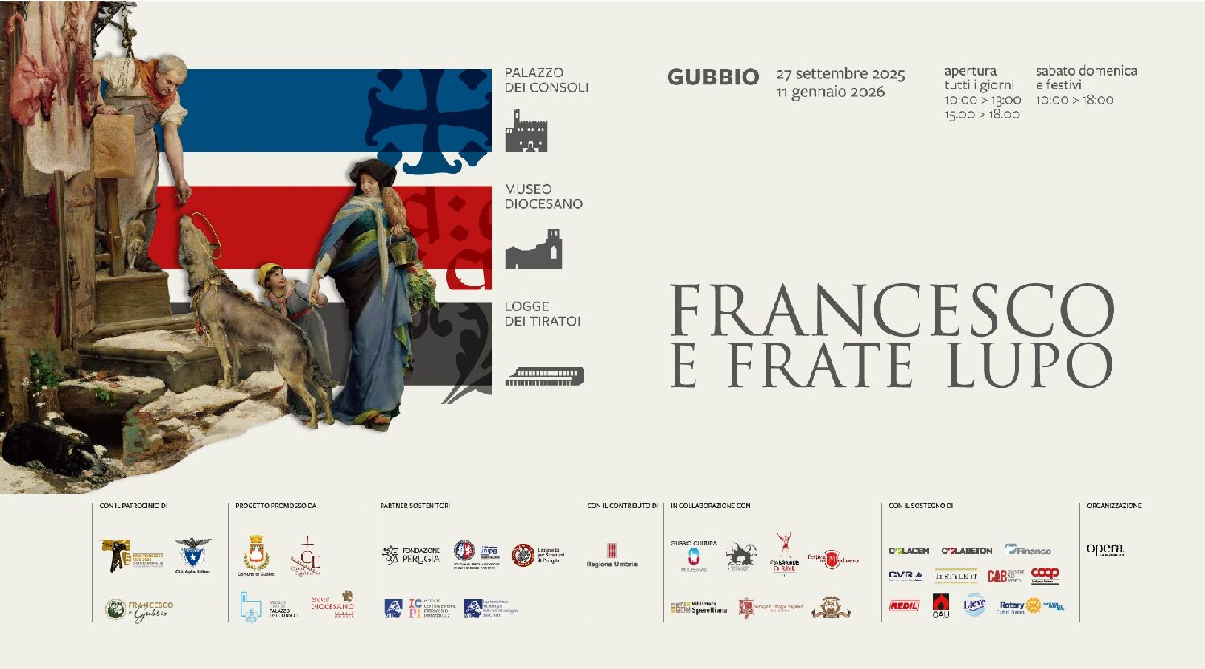

Slide 3
Parchment, also known as vellum or parchment paper, is a membrane made from untreated animal skin (lamb or calf) and composed of collagen. It has a tough yet elastic structure, which means that deterioration does not occur frequently. It was used as a writing support until the 14th century, when it was gradually replaced by paper made from hemp or other textile fibers. Today, it is still used as a binding material.

Slide 4
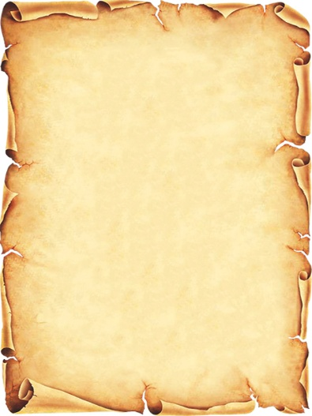

Slide 5
Parchment (known in Latin as membrana or vellum) takes its name from the city of Pergamon, in Asia Minor, where, according to the tradition reported by Pliny the Elder, it was introduced around the 2nd century BC as a substitute for papyrus. Pergamon had a great library that rivaled the famous Library of Alexandria. When Egypt stopped exporting papyrus due to cultural rivalry between the Egyptian ruler Ptolemy V Epiphanes (204–180 BC) and King Eumenes II of Pergamon (196–158 BC), Pergamon responded by producing parchment through the processing of animal skins.
In the ancient world, parchment was not widely used due to competition from papyrus, which was far more abundant and less expensive. Only from Late Antiquity (5th century AD) did the use of parchment begin to increase, eventually becoming the main writing support during the Middle Ages, before being definitively replaced by paper.

Slide 6
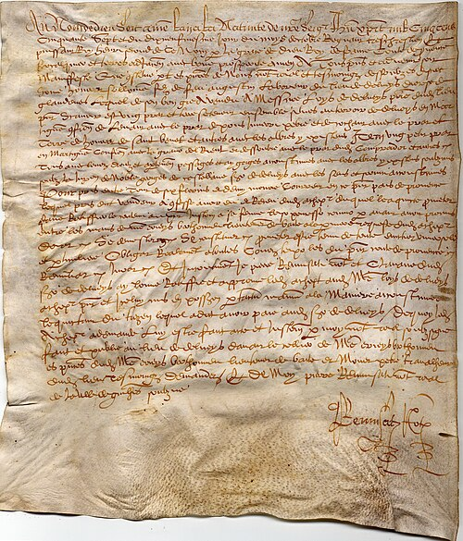

Slide 7
Main Features
Material: Untanned animal leather (sheepskin, parchment), rich in collagen..
Preparation: Washed, depilated, stretched on frames, abraded with pumice, and finished with glue.
Ancient use: Writing support until the advent of paper (14th century), replacing papyrus and wax tablets.
Modern use: Bookbinding, musical instruments, lampshades.
Etymology:From Latin pergamēna, "of Pergamon," a city famous for its libraries, where the practice is said to have been introduced.

Slide 8
OUR CREATIVE WORKSHOP ON PARCHMENT
LET'S LOOK AT THE MAIN STAGES.

Slide 9
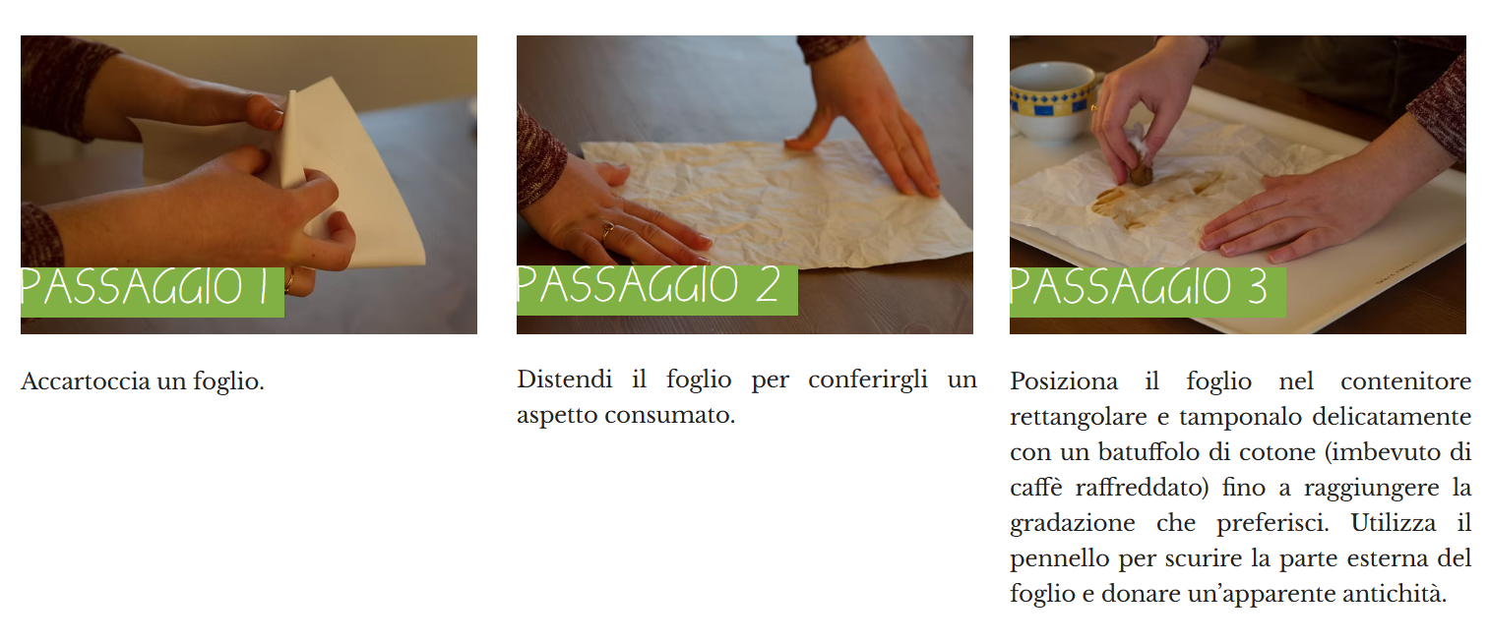
Crumple a sheet of paper.
Flatten the sheet to give it a worn appearance.
Place the sheet in the rectangular container and gently dab it with a cotton ball (soaked in cooled coffee) until you achieve the shade you prefer. Use the brush to darken the outer edges of the sheet and give it an aged appearance.

Slide 10
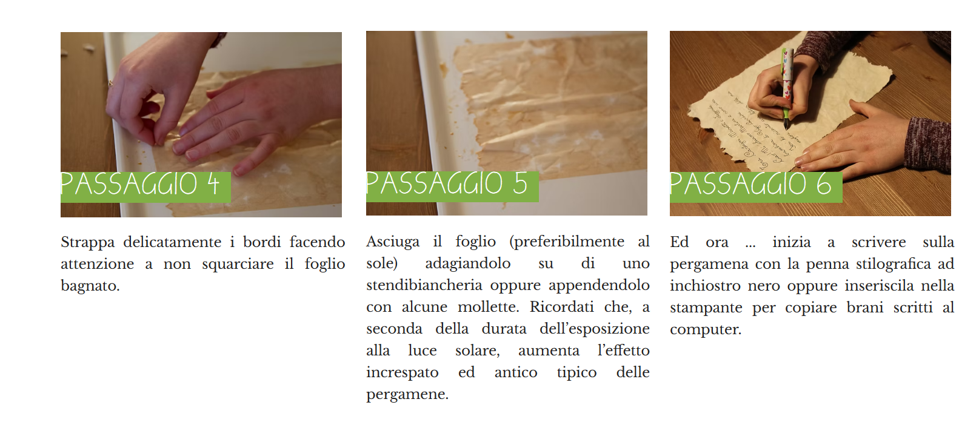
Gently tear the edges, being careful not to rip the wet sheet.
Dry the sheet (preferably in the sun) by laying it on a drying rack or hanging it with some clothespins. Remember that the longer it is exposed to sunlight, the more pronounced the wrinkled, antique effect typical of parchment becomes.
Now, start writing on the parchment with a fountain pen and black ink, or place it in a printer to copy passages typed on the computer.

Slide 11
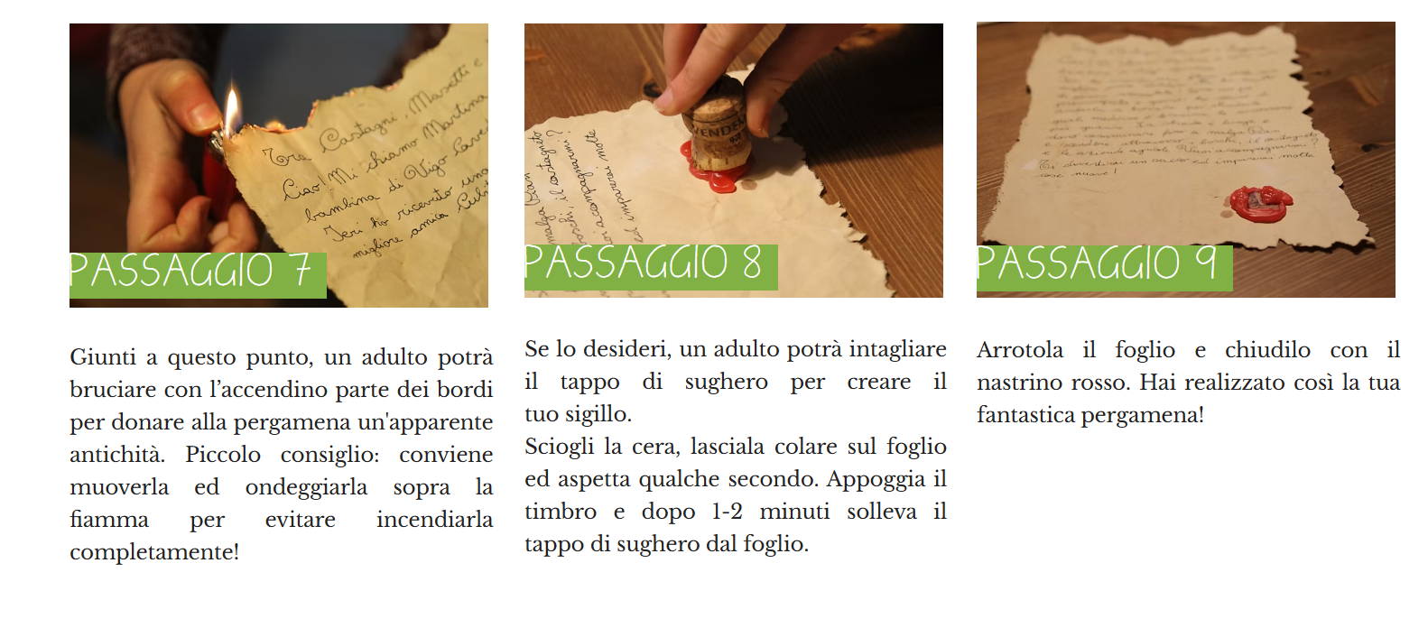
At this point, an adult can use a lighter to singe parts of the edges to give the parchment an aged appearance. Quick tip: it’s best to move and wave it above the flame to avoid burning it completely.
If you wish, an adult can cut the cork stopper to create your seal. Melt the wax, let it drip onto the sheet, and wait a few seconds. Press the stamp onto the wax, and after 1–2 minutes, lift the cork stopper from the sheet.
Roll up the sheet and tie it with the red ribbon. This way, you’ve created your very own fantastic parchment.

Slide 12
SAIN FRANCISTOLD THROUGH PARCHMENTS.
In the exhibition Francesco and Brother Lupo, the art tells the legend of their encounter. We find two very precious and ancient parchments, which narrate the stories of Saint Francis in Gubbio. From these parchments, we draw inspiration for the creation of our own parchment..

Slide 13
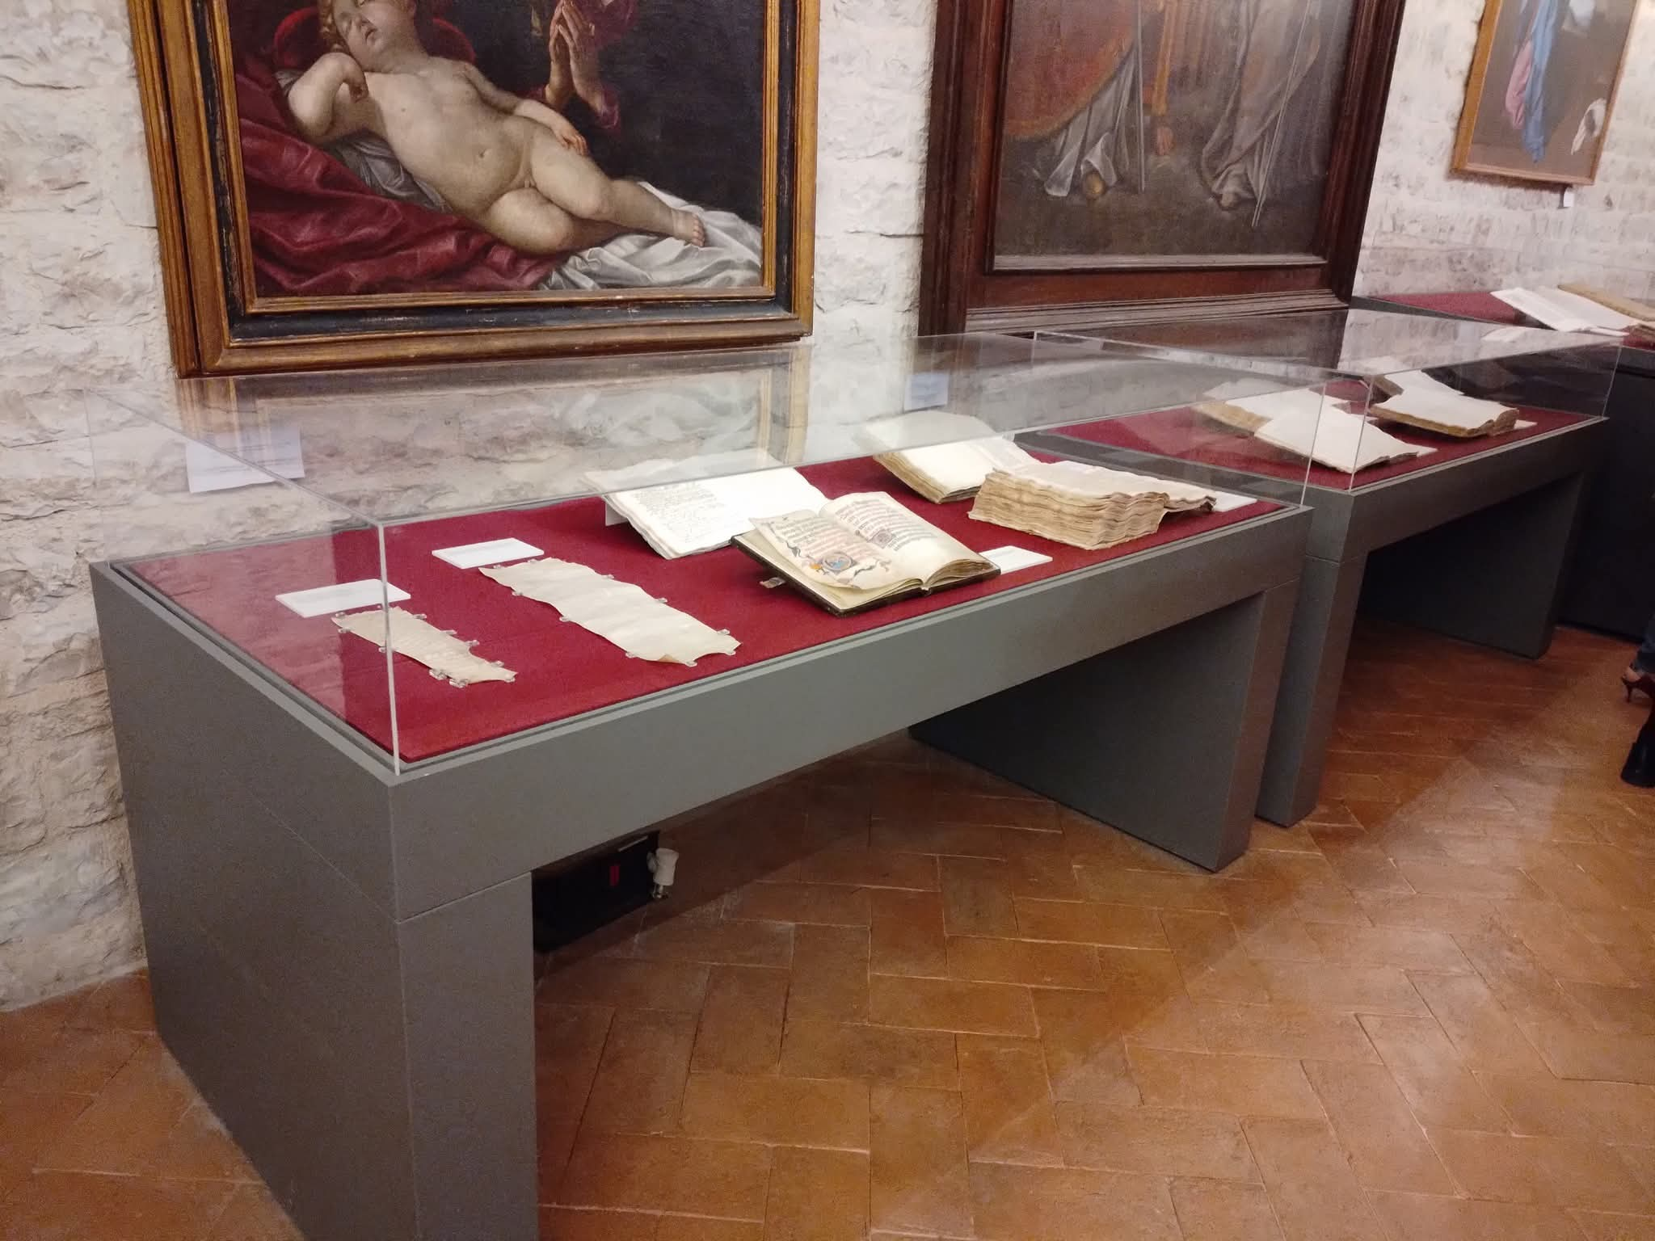

Slide 14
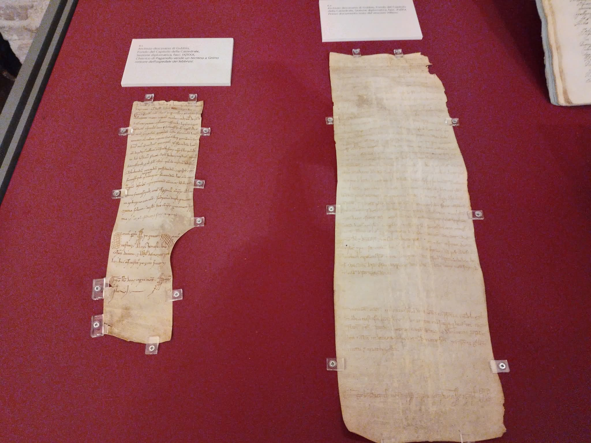

Slide 15
MATERIALS NEEDED
1 sheet of white A4 paper, 150/200 gsm;
Cotton Balls ;
1 wide-tipped paintbrush;
Cooled coffee or burnt umber–colored tempera/watercolor;
1 rectangular container with edges; ;
Fountain pen and black ink;
Lighter;
Cork stopper;
Red wax candle;
Craft knife or small knife;
Satin ribbon;

Slide 16
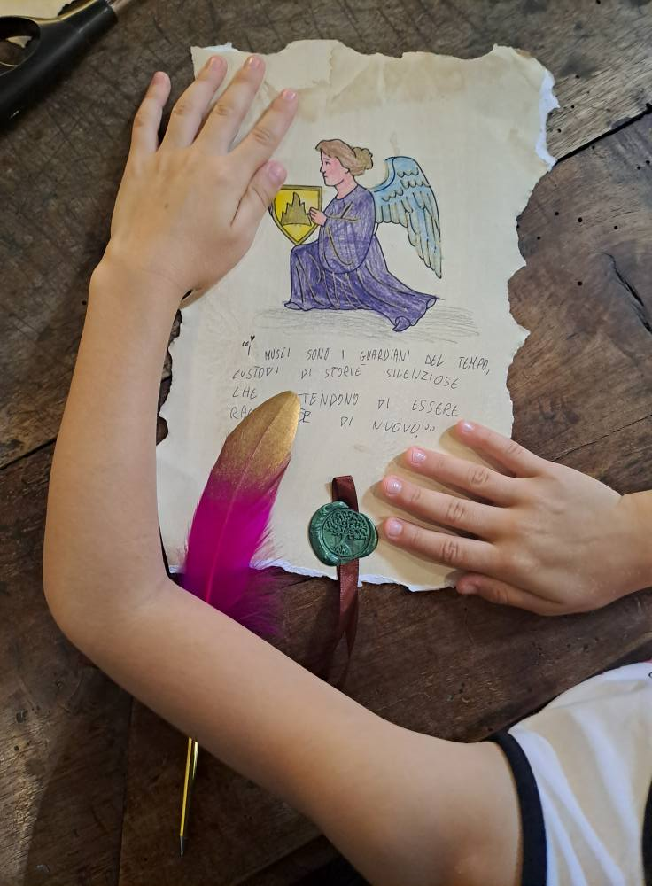

Slide 17
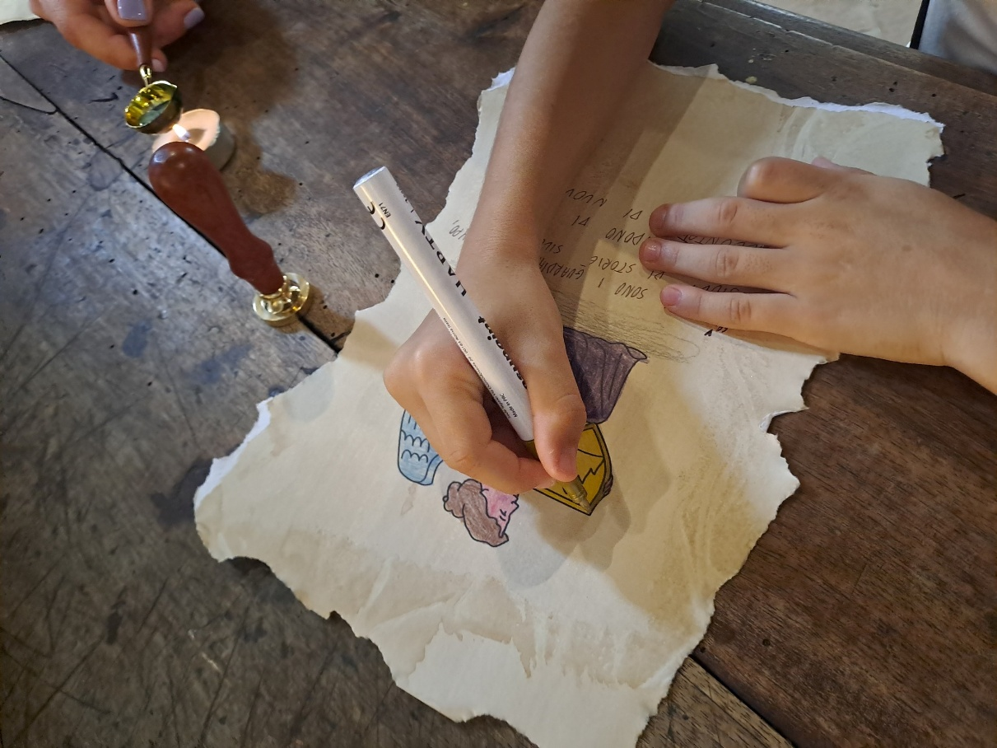

Slide 18


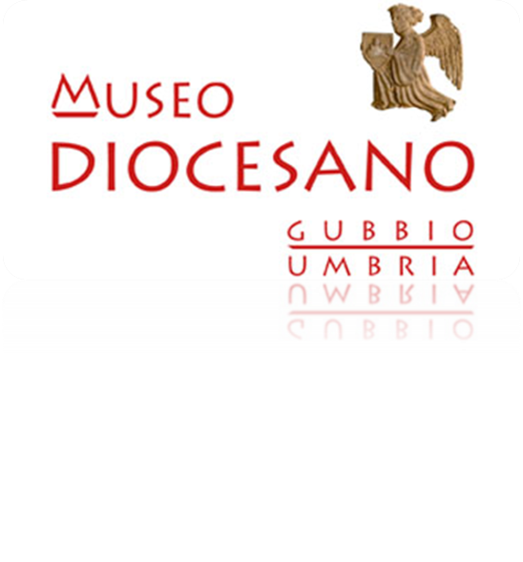
ASSOCIAZIONE CULTURALE LA MEDUSA FOR THE DIOCESAN MUSEUM OF GUBBIO

Slide 19

PRODUCED WITH THE CONTRIBUTION OG
Umbria Region

